Slide 1
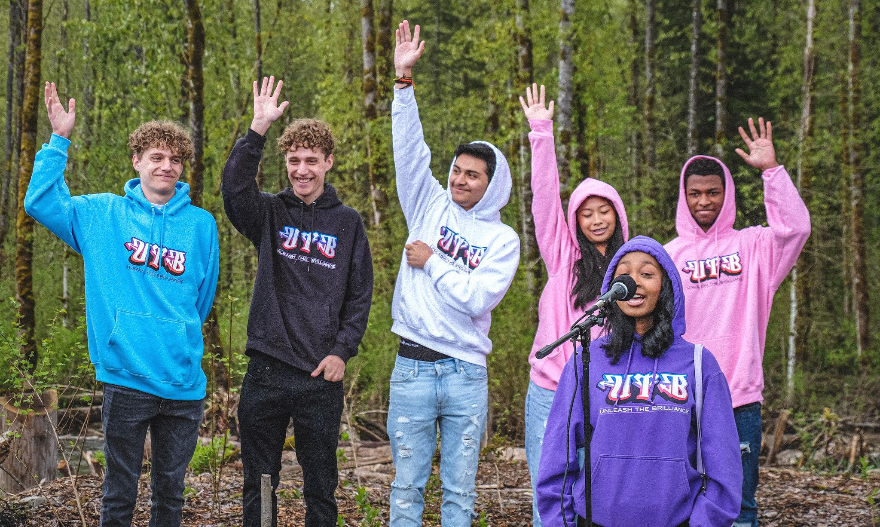
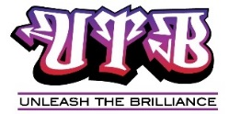
Creating Education Experience with Youth
with Hannah Park
Notes:
Creating educational experience with youth
Introduce yourselves and …
utb is youth mentoring group in South King County that works to reconnect youth to their education
name
age/grade
school
how long we’ve been with utb and luc
future aspirations

Slide 2
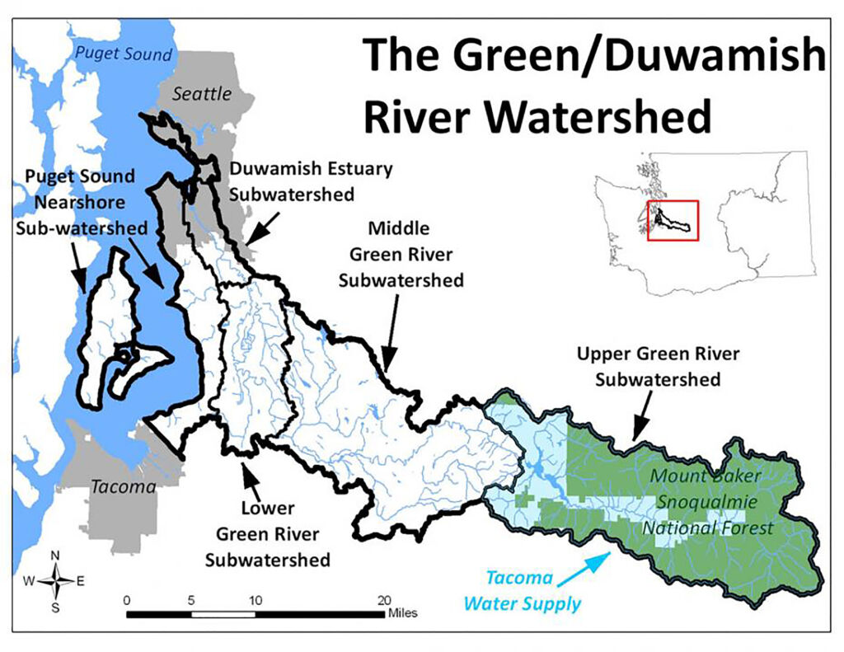
Notes:
Hannah: We focus on the Springbrook basin in the Lower Green River Subwatershed, which drains almost 16,000 acres in Kent and Renton. The eastern half of the sub-basin has steep rolling hills and the western half of the sub-basin is virtually flat. The headwaters of the Springbrook main stem come from springs located near Talbot Road in Renton and provide part of Renton’s water supplies. Panther Lake and some smaller ponds and wetlands are located in the eastern half and also provide water to the creek.
Panther Creek, Garrison Creek, and Mill Creek (not to be confused with Mill-Hill Creek in Auburn) are the main tributaries to Springbrook Creek.
Springbrook supplies nearly all the water to what now remains of the Black River but all this water has to be released to the Green River through a flood-control structure called the Black River Pump Station. This pump station was built in 1970 and is now undergoing planning for seismic and structural repairs including the replacement of an antiquated fish ladder.

Slide 3
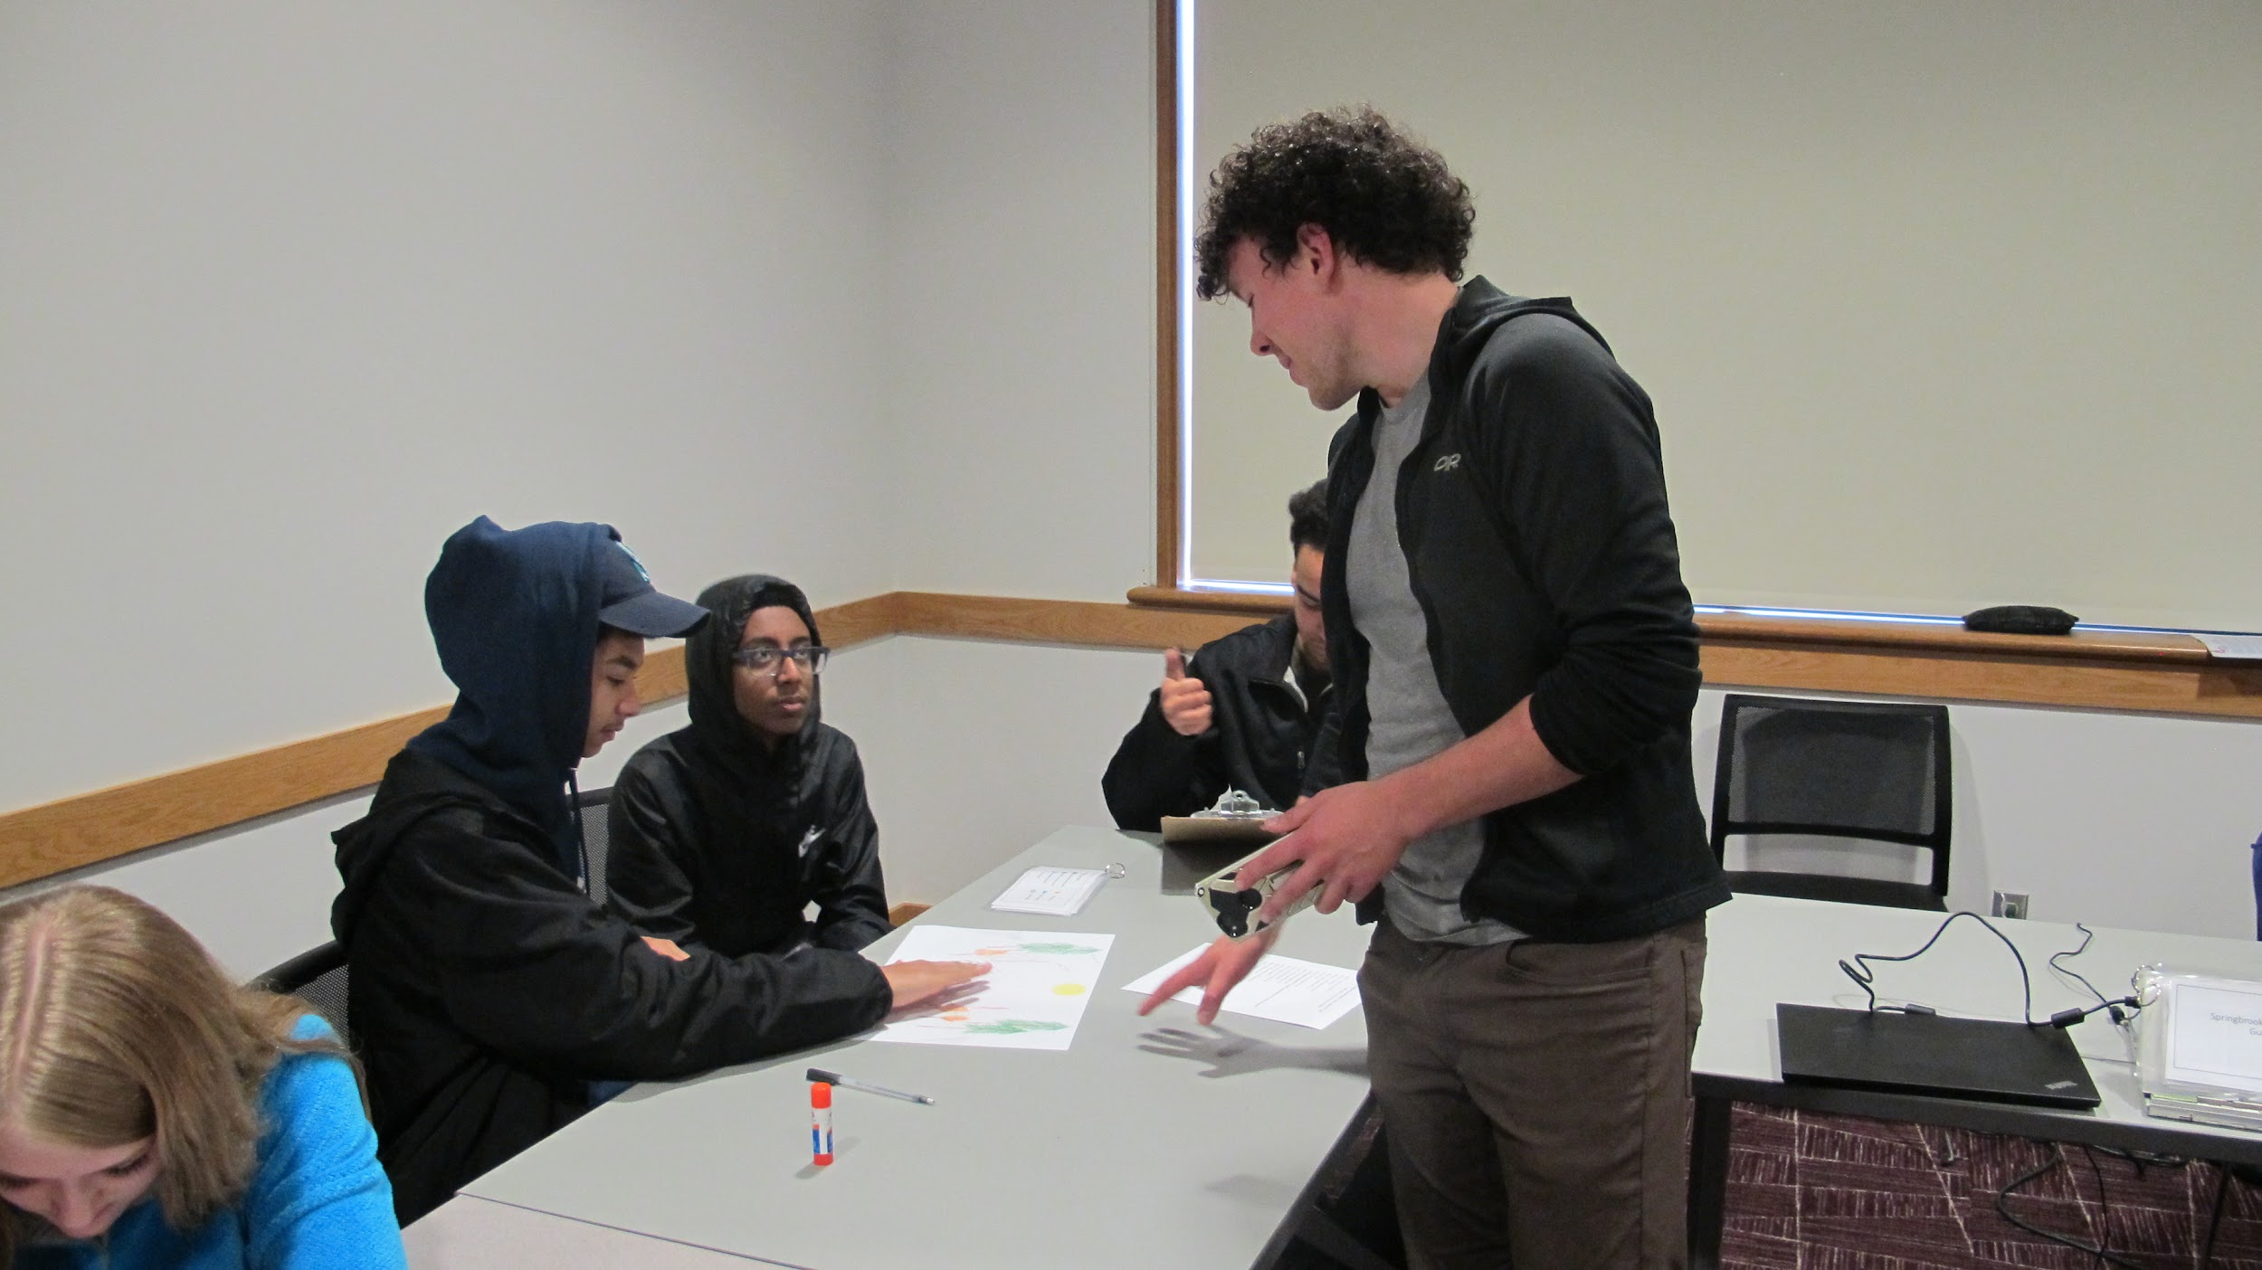
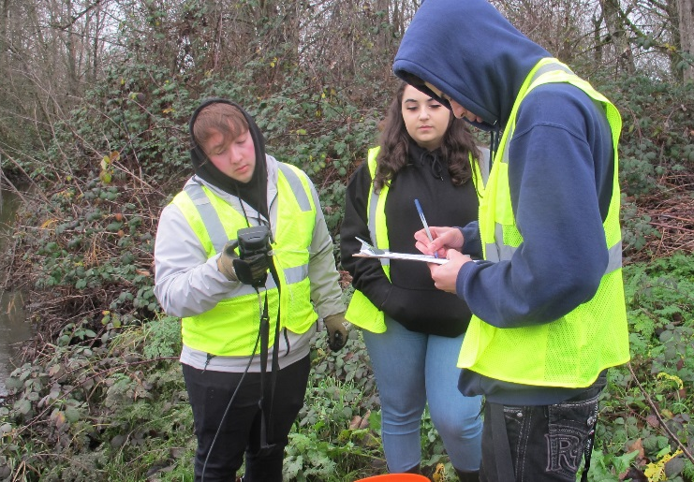
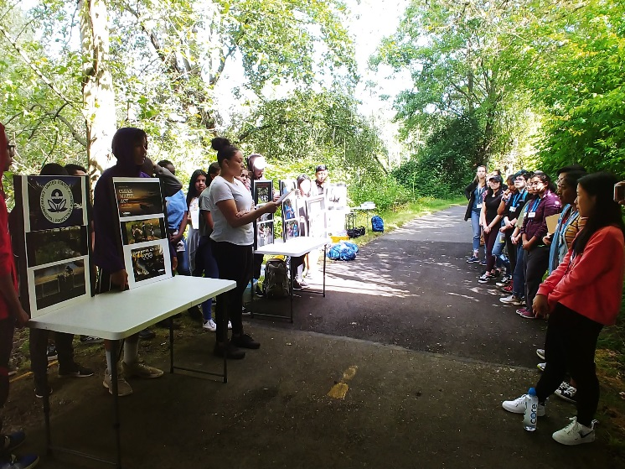
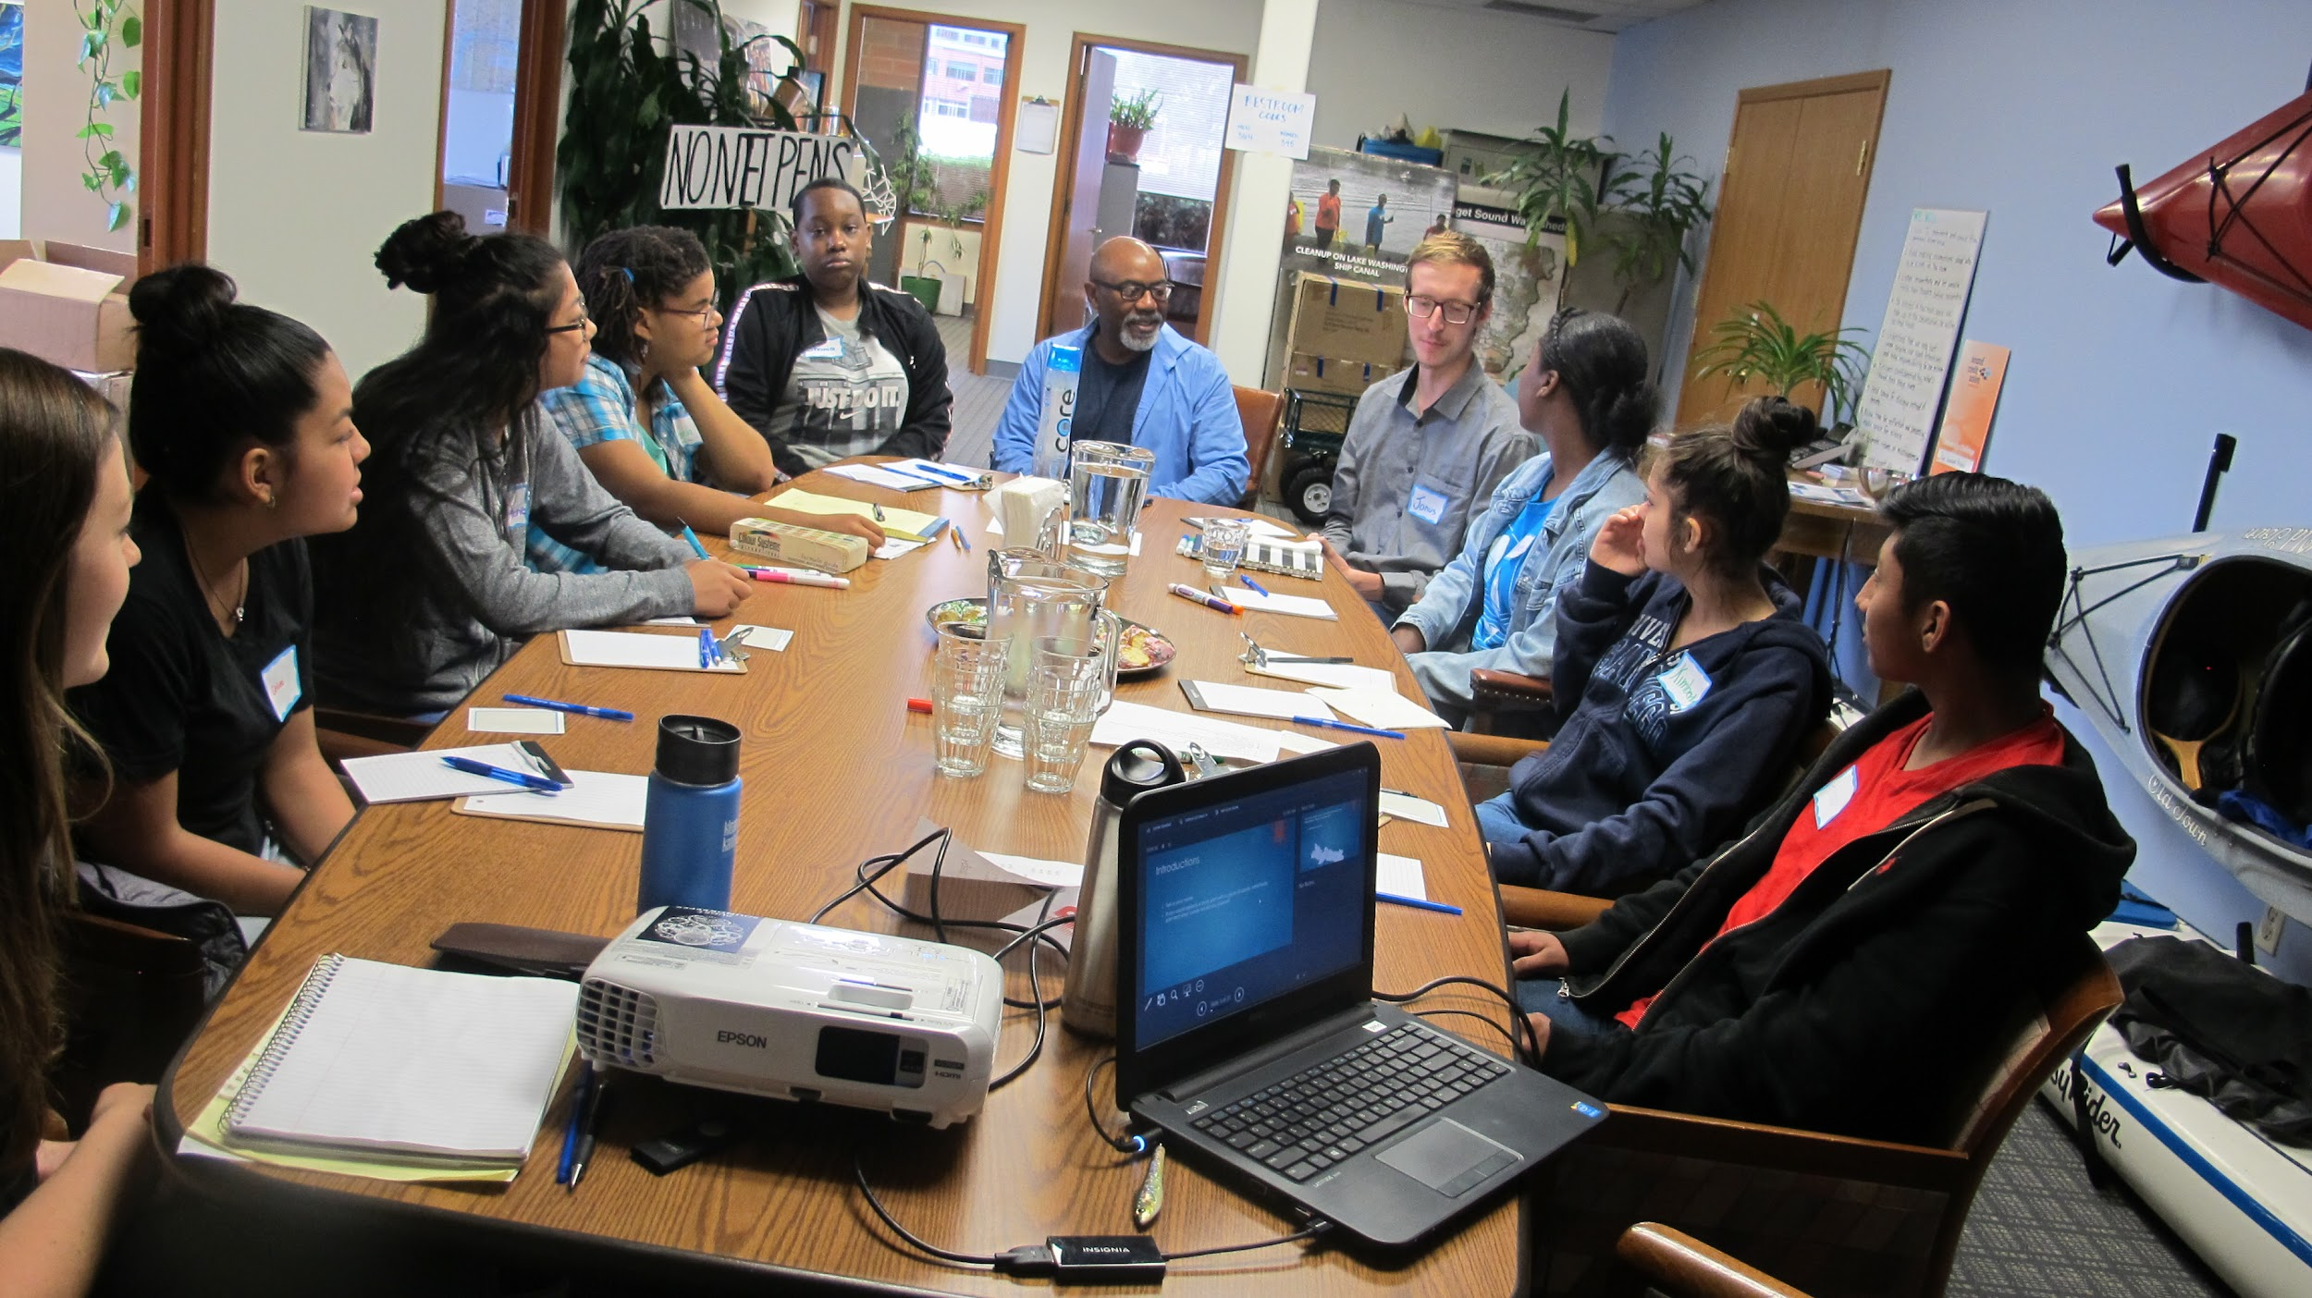
Lost Urban Creeks Project Focus Areas:
1. Education & Skills Development
2. Monitoring Water Quality & Field Investigations
3. Conducting Community Outreach
4. Restoration & Stewardship
5. Equity and Social Justice
Notes:
Hannah: Since 2017, Unleash the Brilliance has been working with the environmental group Puget Soundkeeper on a initiative called the Lost Urban Creeks Project. This project has five focus areas:
1. Organizing Educational programs & developing youth skills
<CLK> 2. Monitoring Water Quality and getting out into the field to conduct investigations
<CLK> 3. Presenting and representing the project to the community and to local decision makers
<CLK> 4. Conducting restoration and stewardship activities
<CLK> 5. Promoting equity, social and environmental justice

Slide 4
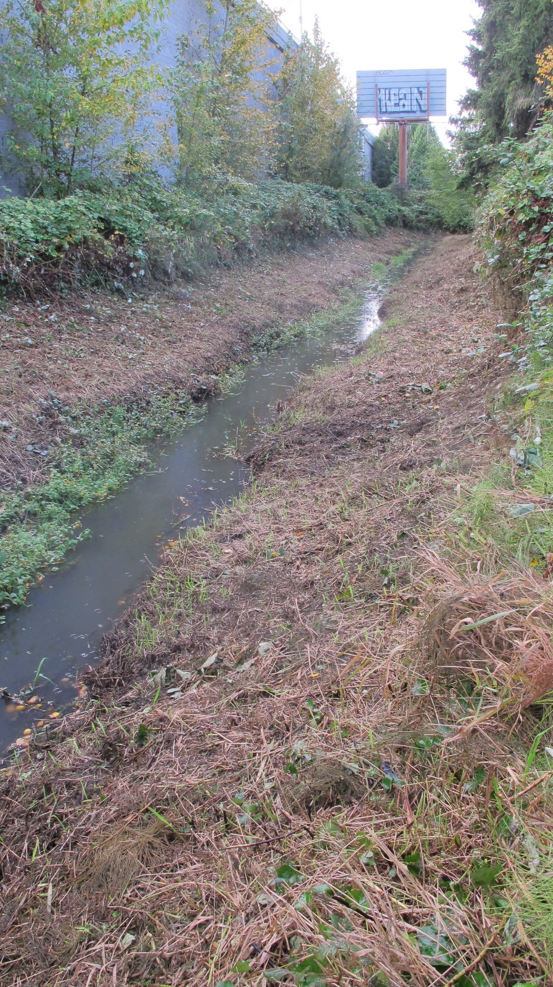
Notes:
Hannah: The creek is heavily modified and is on the State Department of Ecology’s list of impaired streams for violation of dissolved oxygen, bacteria, and bioassessment standards. The creek is also included in the EPA-approved Green River Temperature Watershed total maximum daily load (TMDL) plan.

Slide 5
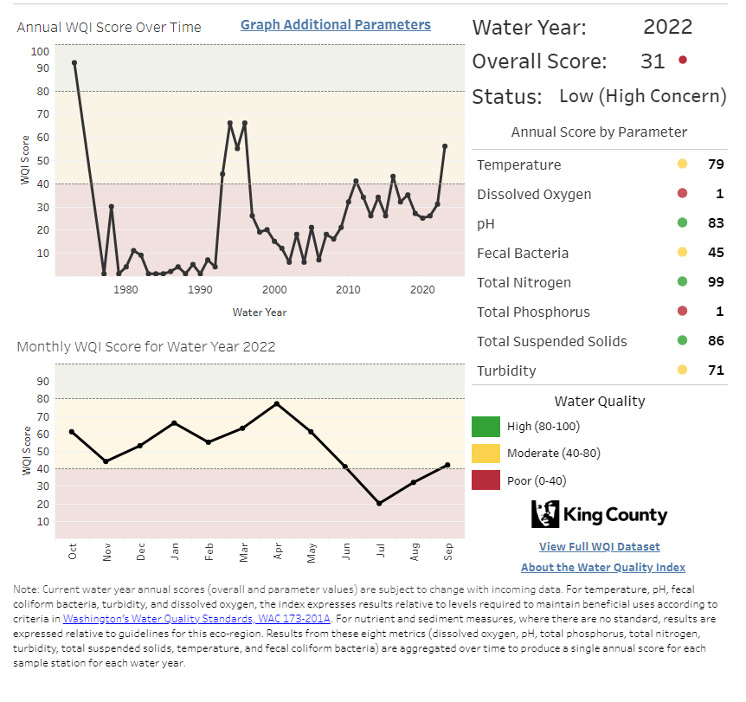
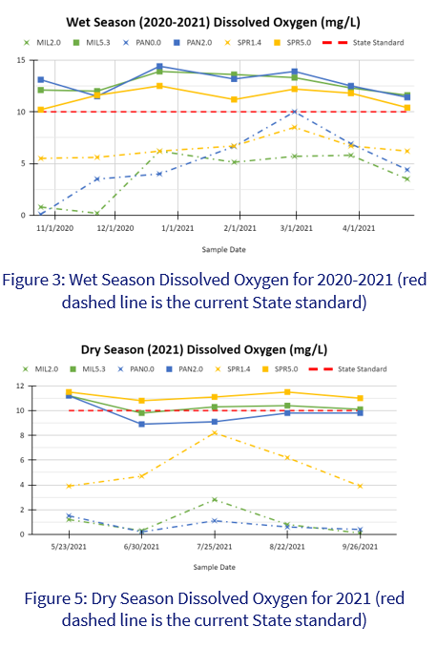
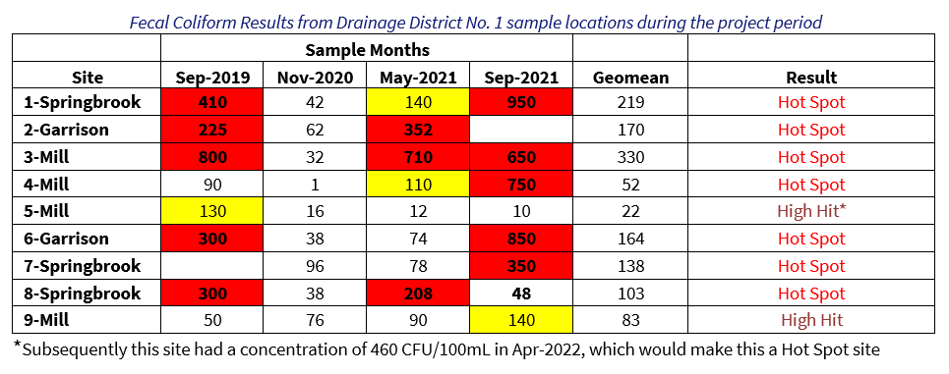
Notes:
Hannah: King County regularly monitors one downstream location in Springbrook Creek along with many other creeks in and around the county. They look at a variety of water quality parameters and have developed a water quality index or WQI that rates the overall water quality on a scale from 1 to 100, with a score of 100 being a high water quality rating. In 2022, four creeks were rated as being of low quality in King County and thus of high concern. These were Evans Creek northeast of Lake Sammamish (with a Water Quality Index of 33), Issaquah Creek (Index of 38), Rock Creek in Black Diamond (with one of 18) and Springbrook in Renton (with an Index 31).
<click> We monitor water quality data every month at eight stations in Springbrook’s watershed and saw problems with both temperature and dissolved oxygen levels, with dissolved oxygen showing reduced levels in some stations in both the wet and dry seasons.
<click> And Drainage District No. 1 monitors 9 stations in Springbrook’s watershed twice a year. It has a wealth of data including this bacteria data showing that seven out of their 9 stations are hot spots for contamination.

Slide 6
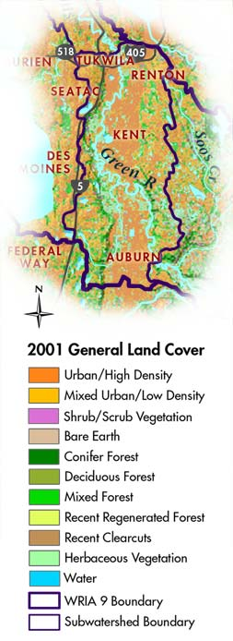
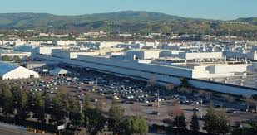
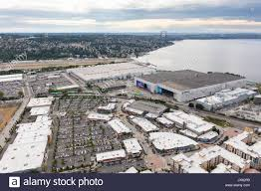
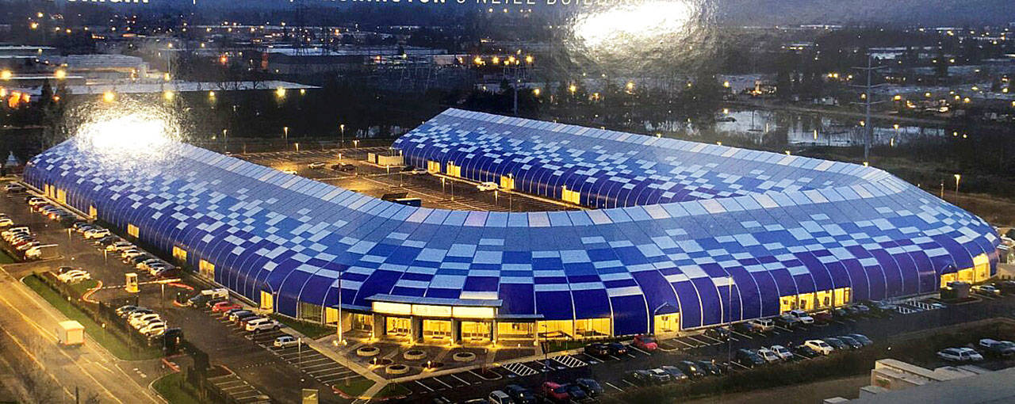
Notes:
Hannah: We understand what some of the key problems are for Springbrook. Ninety percent of the basin is covered by low to high-density residential, commercial and industrial development. This is a map from 2001 but it still shows pretty clearly what this landscape looks like in this part of the Green River today.
In this area, you will often find large developments, including corporations like Boeing and Amazon, which have enormous, sprawling complexes and acres of roads and parking lots.
This type of development has caused polluted stormwater to enter our creeks and has resulted in a loss of riparian vegetation and habitat for our iconic salmon. We all know that this is also one of the most racially and economically diverse areas of the County and like Springbrook Creek these communities are suffering from higher health risks that are linked to pollution in the air, lands and waters of these communities.

Slide 7
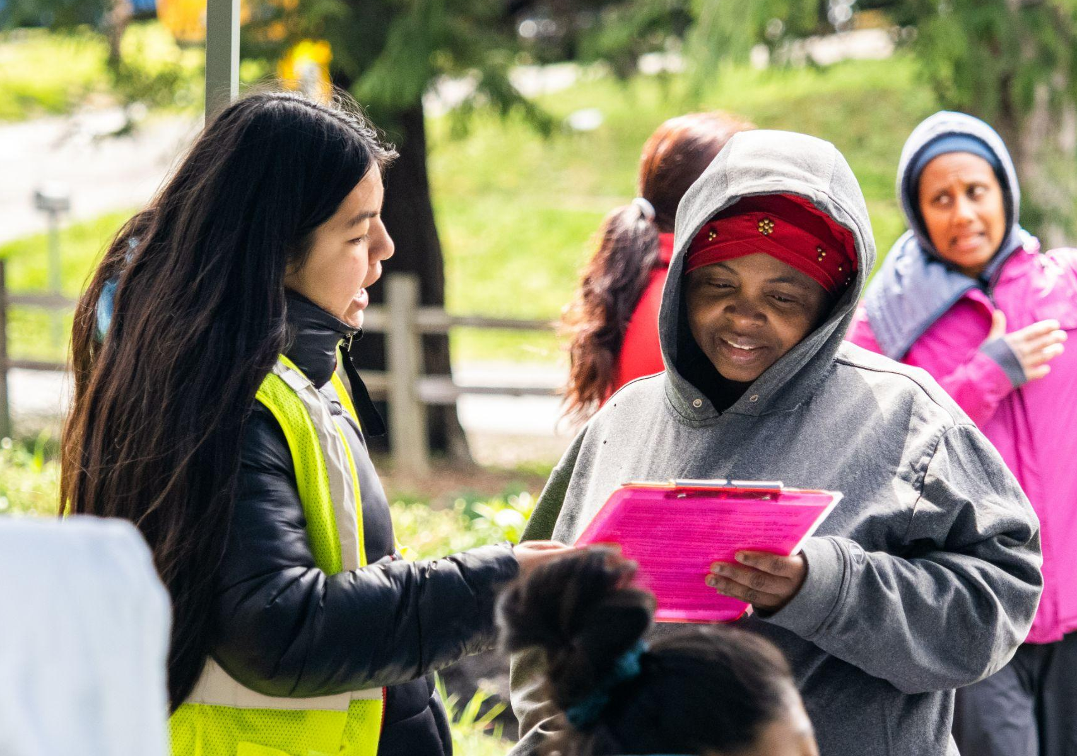
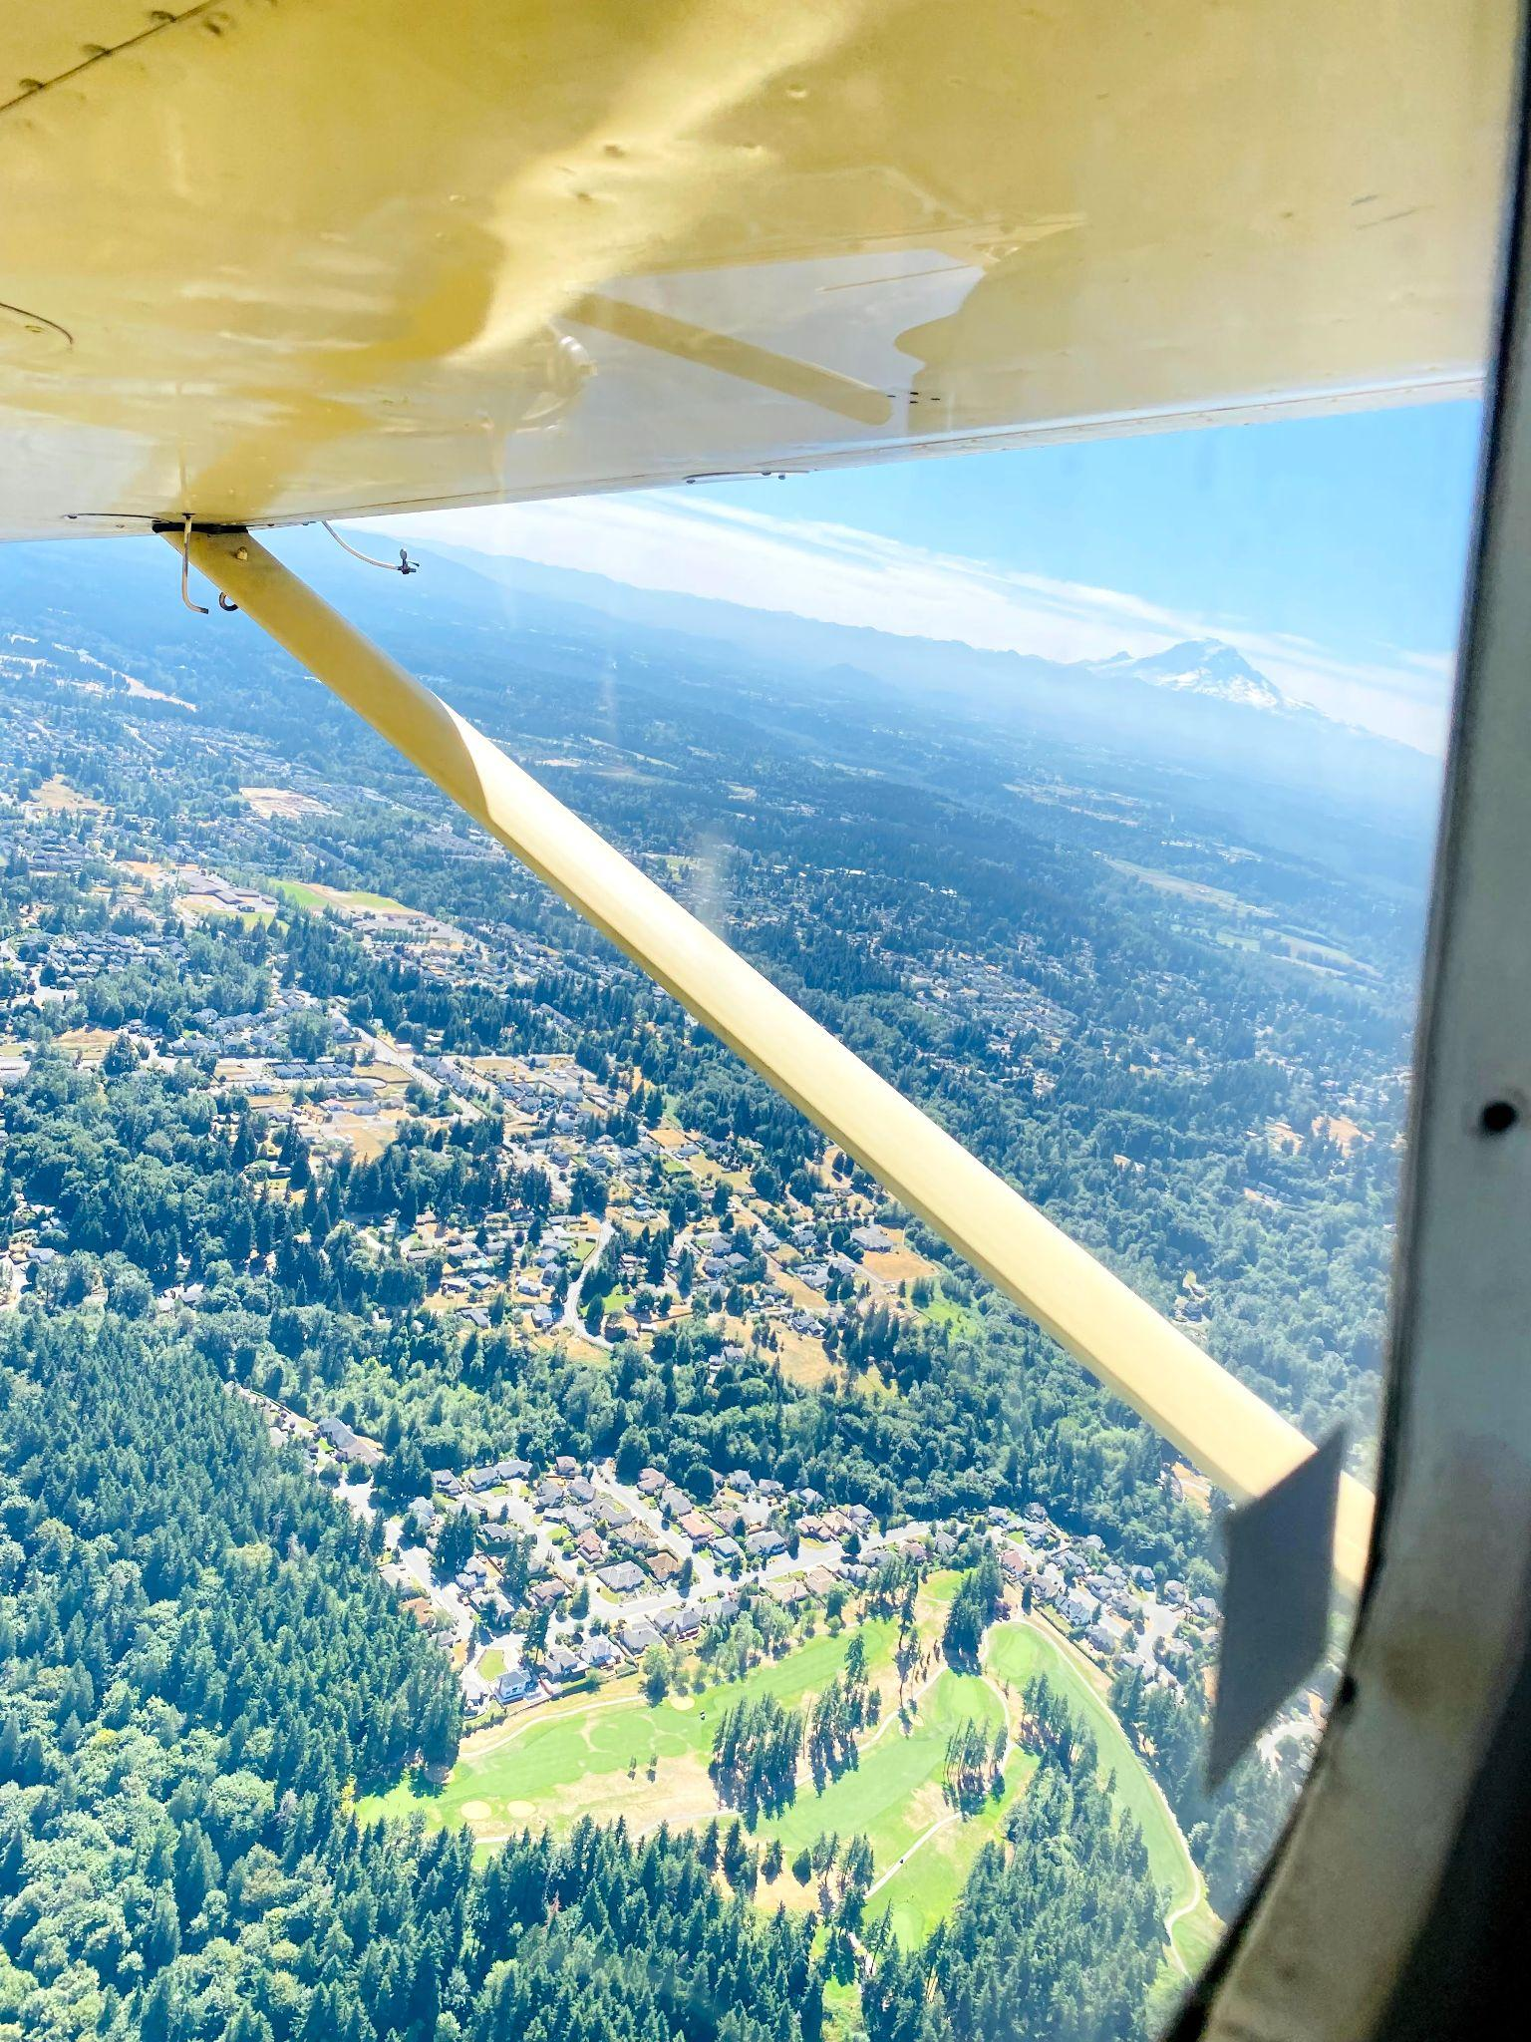
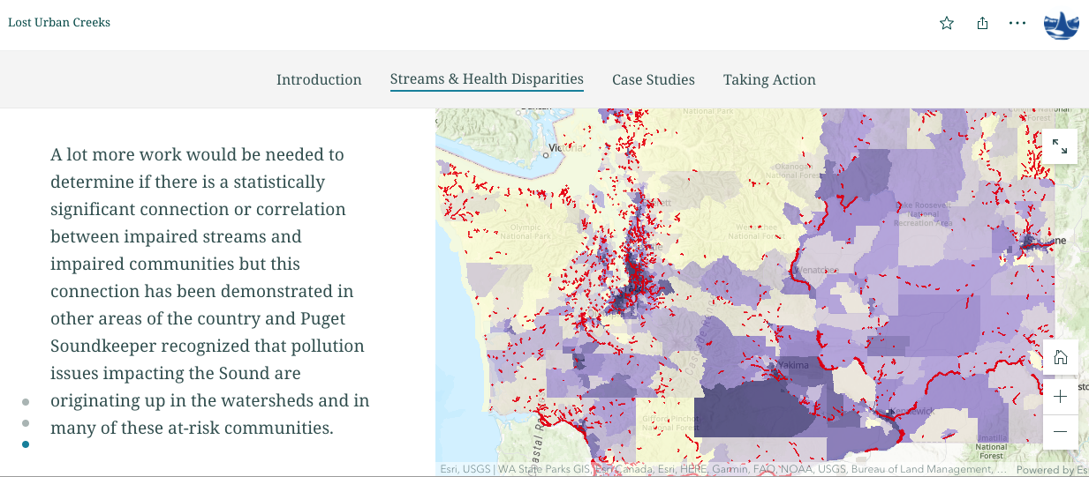
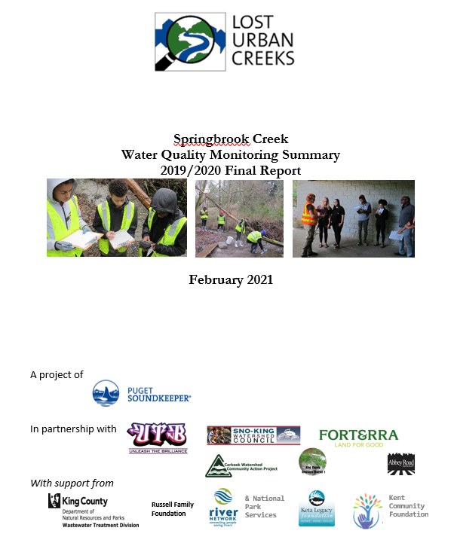
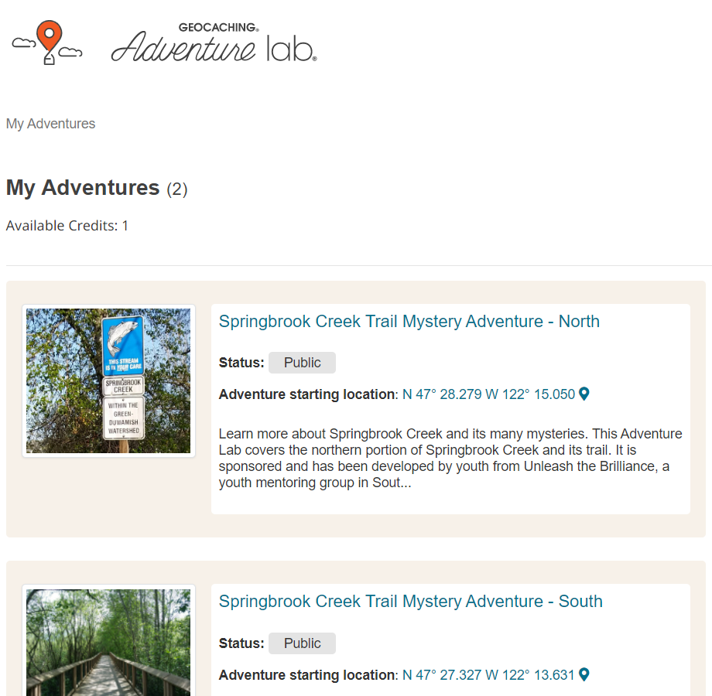
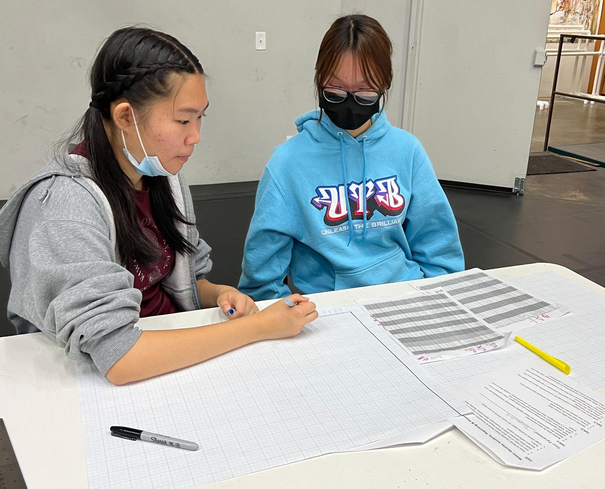
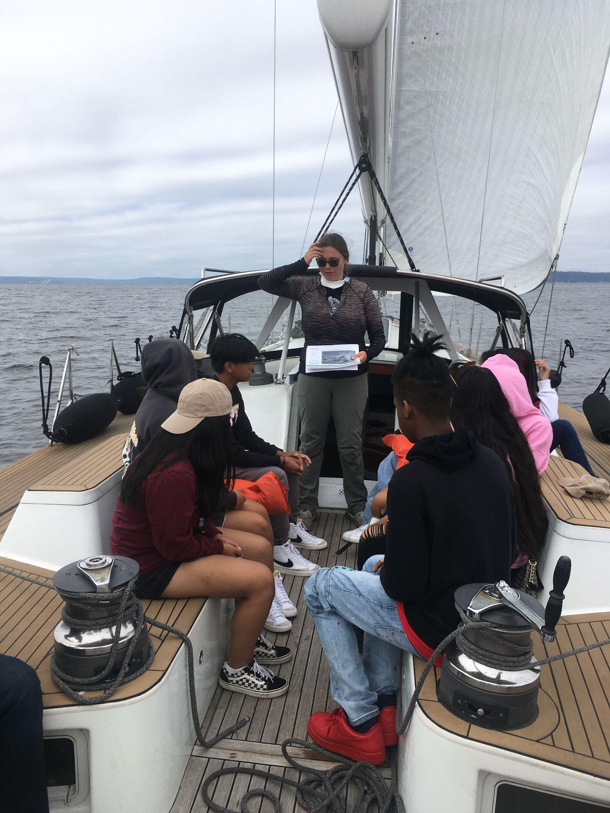
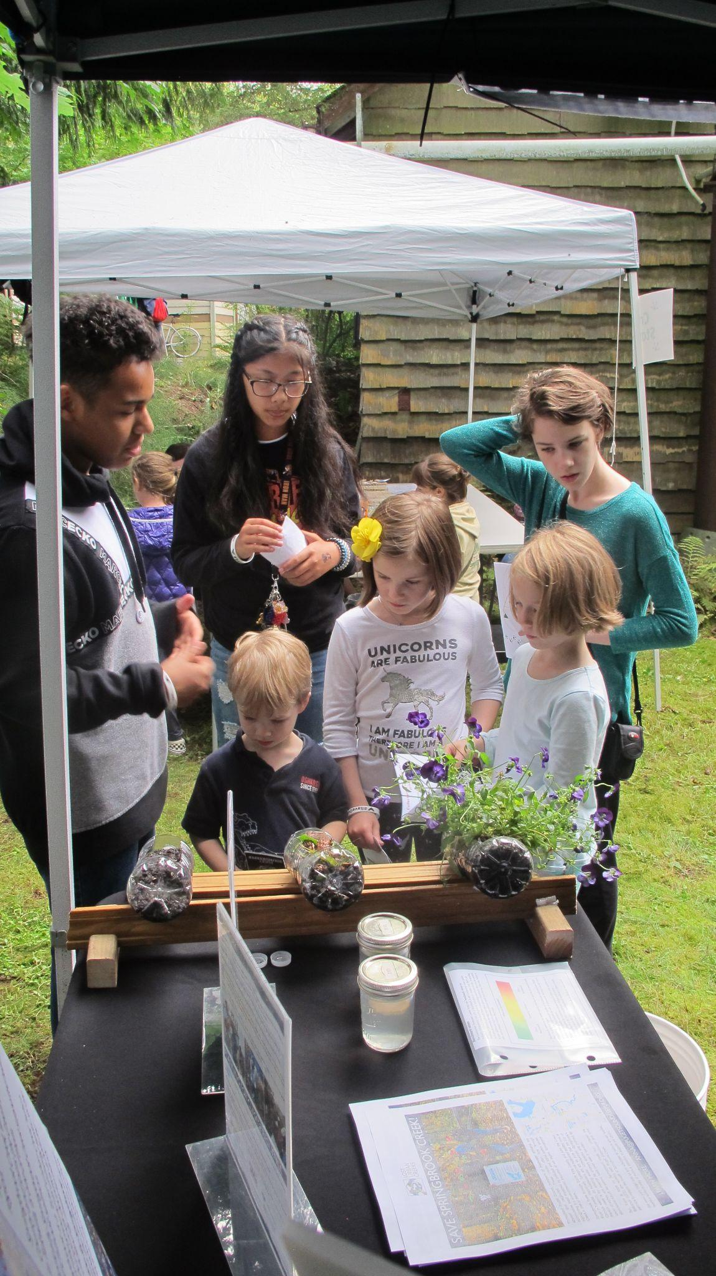
Creating educational experiences for youth …
Notes:
Hannah: Our project has worked to create educational experiences for youth and we’ve done this a number of ways. One example is a project that the youth made to help the general public learn about our creek. Using a smartphone app called Adventure Lab created by the company Geocaching.com, we developed two tours along the Springbrook Creek Trail in Renton. This smartphone app allowed us to create a type of scavenger hunt. It asks the users to answer a series of questions that can only be answered by traveling along the trail. These questions prompt the users to learn more about the creek during an enjoyable walk along the trail. We hope to make a similar Adventure Lab along the Mill Creek Canyon in Kent later this summer that will help the public learn about their local urban waterways.
We are also reporting on our regular water quality monitoring and have a Story Map about the Lost Urban Creeks Project. We’ve learn how to do outreach about our work and we continue to participate in a variety of educational activities and share what we’ve learned with others.

Slide 8
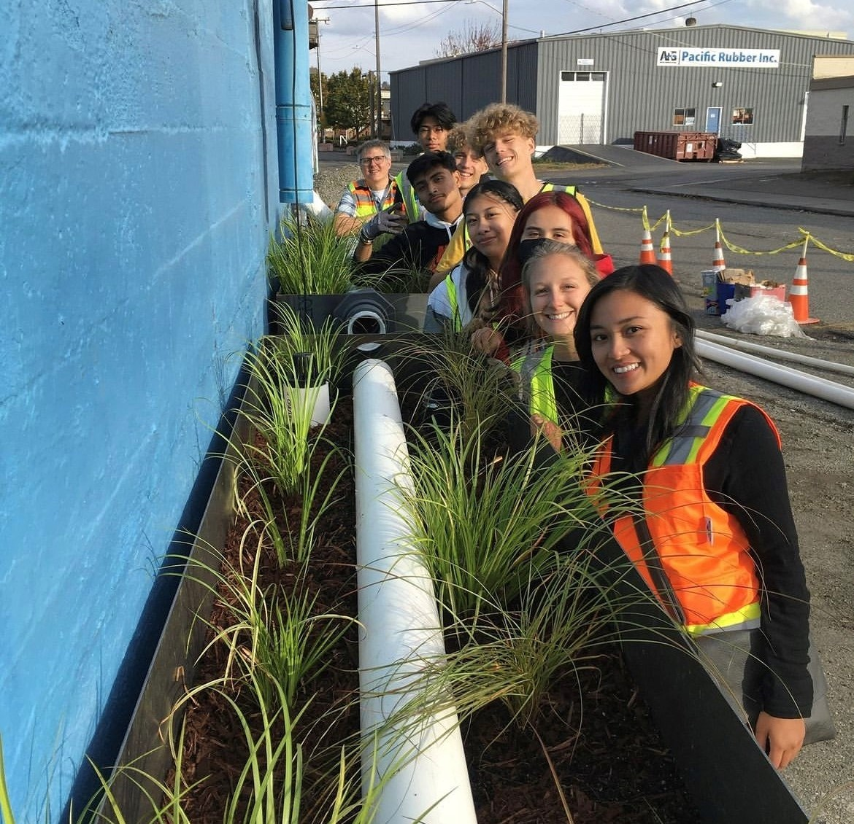
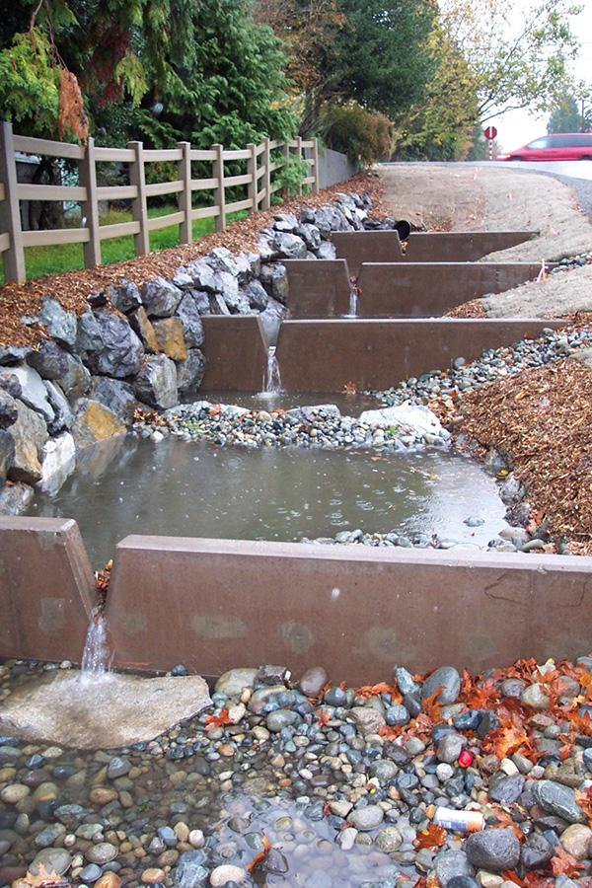
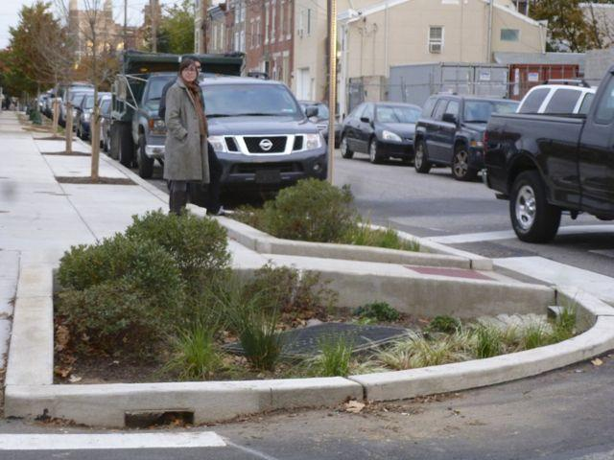
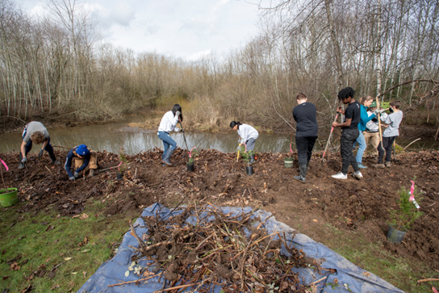
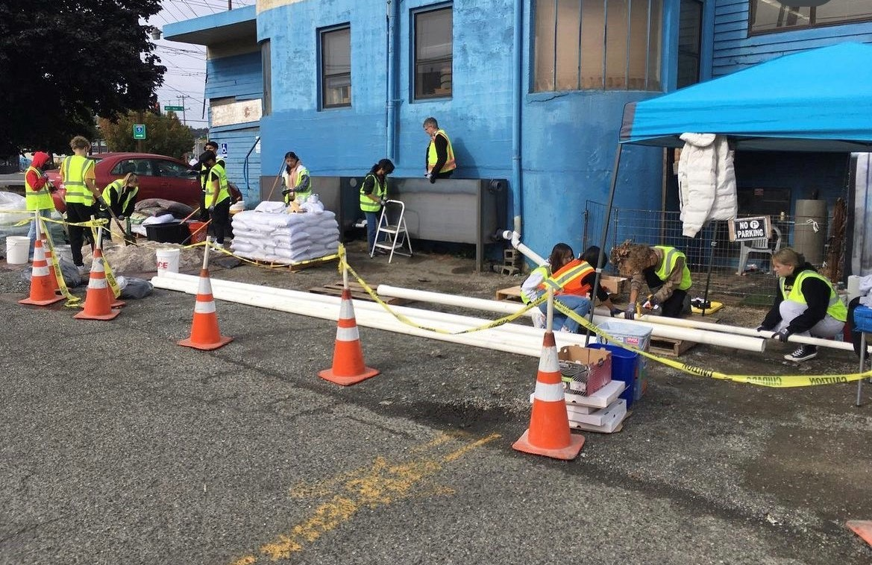
But we know we can do more to help Springbrook Creek
Notes:
Hannah: We have accomplished a lot.
As youth we are here, willing, and engaged but we are alone and we can’t solve problems that were decades in the making. We need the adults in the room to take the problems of our urban creeks seriously. Springbrook has suffered a death from a thousand cuts, but there are great solutions out there that can allow us to reverse this.
You can’t ignore creeks like Springbrook or any of our streams, creeks or ditches … because if you do, you are sacrificing our futures.

Slide 9
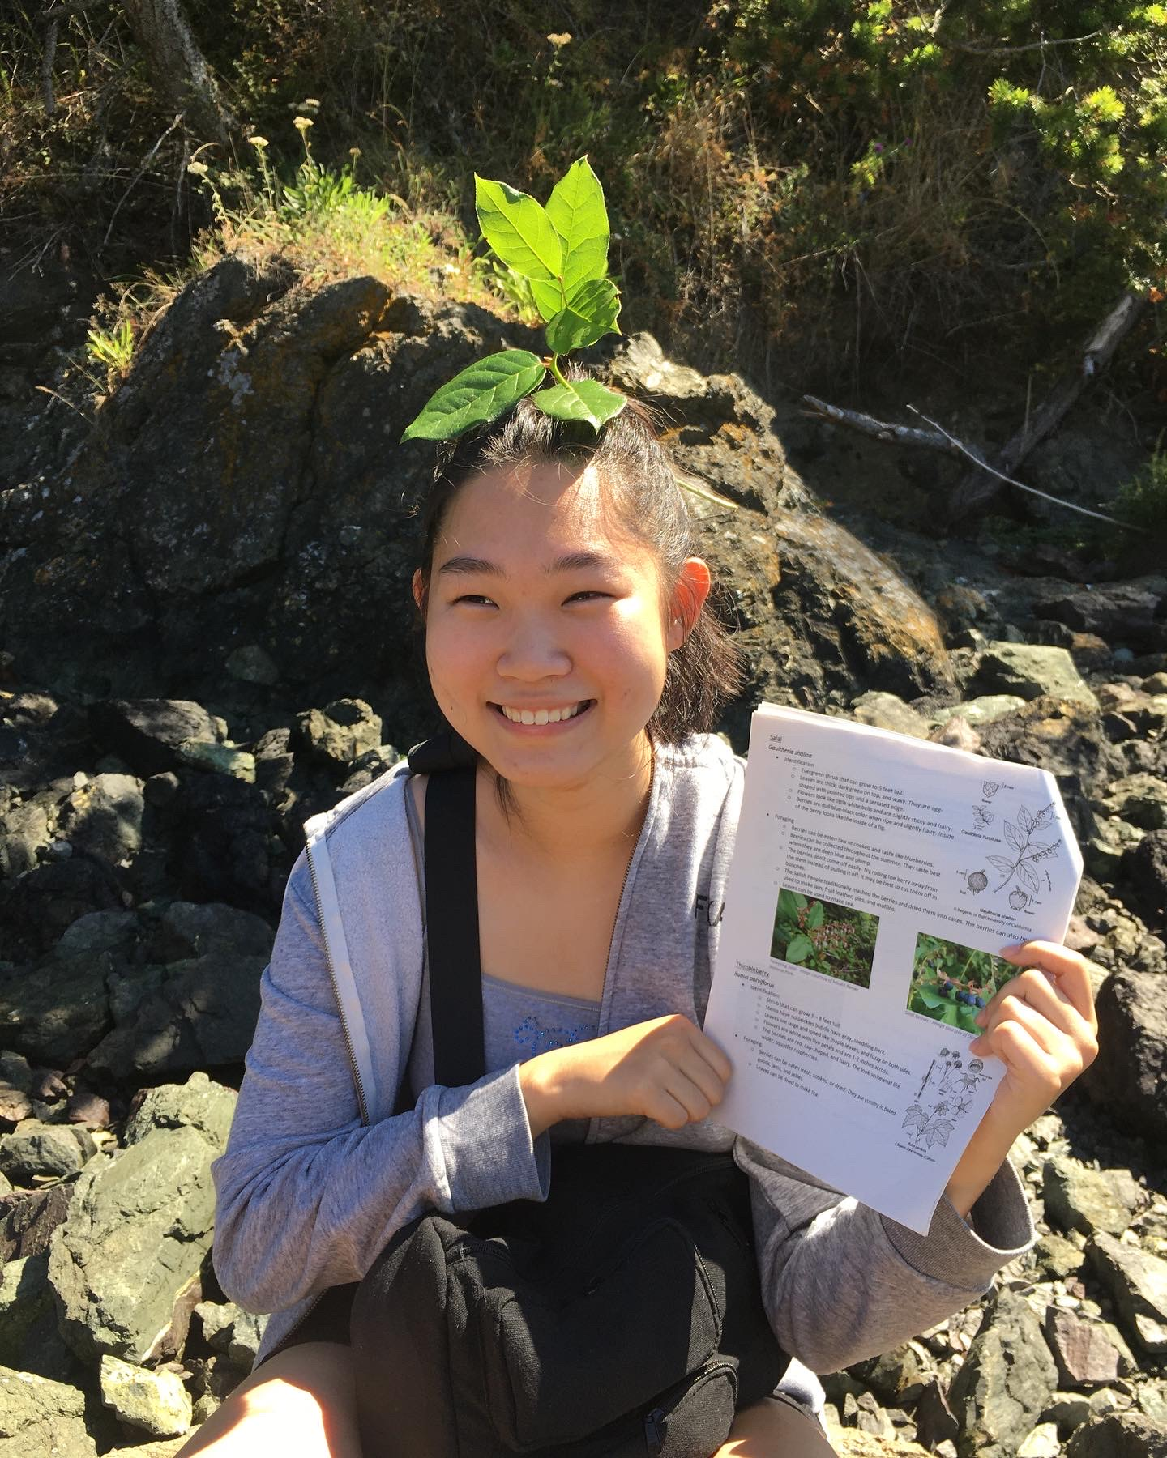
Thank you:
Visit us: https://pugetsoundkeeper.org/programs/lost-urban-creeks/
Learn about us (Lost Urban Creeks Story Map): https://pugetsoundkeeper.org/maps/lost-urban-creeks/
Follow us on Instagram: lost_urban_creek
Our project is supported by King County Wastewater Division and the Russell Family Foundation and we work in partnership with Mid-Sound Fisheries Enhancement Group, Sno-King Watershed Council and Drainage District No. 1
Contact Us: LUC@pugetsoundkeeper.org
But please help us!
Notes:
Hannah: Please visit us, learn about us, follow us and our partners, and contact us … but most of all, please help us!

