Slide 1
RESTORATIVE
Stewarding Our Shared Waters
Ken P. Yocom, PhD
kyocom@uw.edu
Green-Duwamish Watershed Workshop
June 21, 2023
Notes:
Thank you ____________ for the introduction. Hello everyone. I see a lot of familiar faces in the audience and am happy to see you here. For those of you that I have not had the chance to meet yet, I hope to get the chance over the course of the day.
When Sharon reached out to me about a month ago to provide this talk, I jumped at it. It’s a great honor to be invited and I deeply respect and appreciate the work that each of you are doing in the watershed. After thinking about it more though, I became concerned over what I would have to offer that would extend the work already being accomplished. As I dug into reviewing websites, blogs, and newsletters I was overwhelmed with all the supportive activities that are being conducted in the watershed with individuals, community organizations, public agencies, and even my own institution, the University of Washington.
This said, this talk isn’t one that is necessarily going to forge new ground or change direction of activities, but is hopefully understood by each of you as confirmation of the strong work you are already accomplishing.

Slide 2
Directions
+ Influences
+ Personal Engagement
+ Framing
+ Modeling Knowledge
+ Innovative Practices
+ Next Generations
Notes:
As with any good talk, here is a brief outline of what I am going to pass on to you today. Having provided talks like these in the past and having attended many graduations as a faculty member at UW, I know that the opening address should be directed and concise as the heart and intention of this meeting are the activities and conversations that occur afterward. I will begin with influences

Slide 3
In Collaboration (not an exhaustive list)
Stephanie Malin
Lynne Manzo
Brice Maryman
Anu Mathur
Zachary McBride
Rosario-Maria Medina
Scott Melbourne
Brett Milligan
Jake Minden
Bob Mugerauer
Charles Nilon
Julian Olden
Polly Olsen
Christina Owen
Kristi Park
Julie Parrett
Niccolo Pianceneti
Andrew Prindle
Gundula Proksch
Rico Quirindongo
Osama Quotah
Maria Ramierez
Laura Reed
Iain Robertson
Molly Adolfson
Coco Alarcon
Marina Alberti
Betsy Anderson
Myla Aronson
Leann Andrews
Celina Balderas Guzman
Jeff Babienko
Michelle Benetua
Kofi Boone
Jeff Bouma
Susan Buis
Ariana Cantu
Christopher Campbell
Manish Chalana
Mark Childs
Margaret Clancy
BJ Cummings
Dilip da Cuhna
Catherine De Almeida
Kimberly Deriana
Amelie Des Plantes
Barbara Deutsch
Danielle Devier
Nick Dreher
Nicole Faghin
Lauren Flemister
Clifford Geertz
Jolene Haas
Stephen Handel
Cecile Hansen
Kristina Hill
Jeff Hou
Jack Hyland
Cleo Hazard Woelfle
Selena Hunstiger
Mark Johnson
Meghan Kallman Andrew Karvonen
Linda Krippner
Alejo Kraus-Polk
Alicia Kellogg
Mikyoung Kim
Bobbie Koch
Jennifer Kreigel
Tim Lehman
Clarita Lefthand-Begay
Katherine Lynch
Nancy Rottle
Anne Shaffer
Amir Sheikh
John Smith
Ben Spencer
Tim Spenser
Fredrick Steiner
Brooke Sullivan
Anna Tamura
Anne Taufen
Jake Thoennes
Jac Trautman
Stephen Trigueiro
Rishabh Ukil
Fritz Wagner
Mackenzie Waller
Jeremy Watson
Julia Watson
Thaisa Way
Thomas Whittmore
David Williams
Steve Winter
Ken Workman
Peter Yocom
Notes:
None of the work I do, or you quite, frankly, succeeds when completed in isolation. This is a not an exhaustive list, but a list none the less of individuals who came to mind as I developed this talk. Some are folks I actively work with daily, and others are folks I only know by the work they have and are accomplishing, but each has influenced me and my perspectives, and I thank them all. As we will discuss, I believe the power and impact of our work comes not from individual accomplishments but in the lasting relations we build to one another and the places in which we live, work, and play.

Slide 4
Water is fluid, soft, and yielding. But water will wear away rock, which is rigid and cannot yield. As a rule, whatever is fluid, soft and yielding will overcome whatever is rigid and hard. This is another paradox: what is soft is strong
- Lao Tzu
Notes:
Continuing, I begin with three quotes that are influential in my work. As an academic, scholarly investigations and perspectives help to frame my intellectual approach – provide inspiration, but also areas of critical investigation.
The first you see here is by Lao Tzu – a Chinese philosopher and author of the treatise Tao Te Cheng which provides direction on how to live in the world with goodness and integrity. While the topic here, water, is certainly pertinent to our conversations today - the intention of the message in my interpretation is that rigid conceptions of what will work and what is impossible should not be caste in these terms alone– but can be engaged through continuous efforts – efforts that are collaborative, adaptable, accommodating, and empathetic.

Slide 5
‘The face of the water, in time, became a wonderful book — a book that was a dead language to the uneducated passenger, but which told its mind to me without reserve, delivering its most cherished secrets as clearly as if it uttered them with a voice. And it was not a book to be read once and thrown aside, for it had a new story to tell ever day.’
—Mark Twain, Life on the Mississippi
Notes:
The second quote by Mark Twain is one in which several of the landscape architects in this room may recognize this passage as it is used as a foundation for one of our seminal texts that has helped to establish the contemporary canon in the discipline. With this statement, what I appreciate is that while change is constant, our endeavors and actions provide us with a solid set of experiences for both understanding the past, but also anticipating the future.

Slide 6
‘The face of the water, in time, became a wonderful book — a book that was a dead language to the uneducated passenger, but which told its mind to me without reserve, delivering its most cherished secrets as clearly as if it uttered them with a voice. And it was not a book to be read once and thrown aside, for it had a new story to tell ever day.’
—Mark Twain, Life on the Mississippi
Notes:
Within this statement, two words stand out to me, the first ‘face’ I ascribe to the spatial and the recognizable, and time – referencing this change I was speaking about. While it might seem elementary in our line of work it is the combination of these scales that inform the highly complex work we do in environmental restoration and rehabilitation

Slide 7
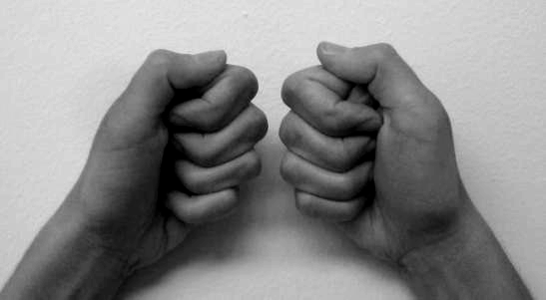
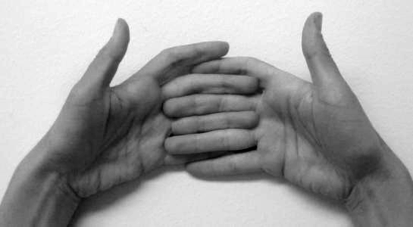
z
space
x
y
time
Notes:
It is through our merging of these scales that we can gain a better understanding of not only our impact, but in the directions we have to engage in the future opportunities presented to us.

Slide 8
© Mathur and da Cuhna
Reading the complex relationships of a place requires rejecting “thin descriptions” and, instead, creating “thick descriptions” that engage a “multiplicity of complex conceptual stories, many of them superimposed upon or knotted into one another, which are at once strange, irregular, inexplicit.”
- Clifford Geertz
Notes:
The final quote may also be recognizable to some of you is from Anthropologist Clifford Geertz, in which he writes about the complexity of place and the depths one must engage with to begin to unravel the strange, irregular, and inexplict – For it is with deep knowledge of place that we can begin to affect change.
Together, these quotes bring together the concepts of change, adaptability, and commitment that are so necessary when engaging in a holistic approach to environmental restoration, whether at a basin or site scale.

Slide 9
Directions
+ Influences
+ Personal Engagement
+ Framing
+ Modeling Knowledge
+ Innovative Practices
+ Next Generations
Notes:
Moving on to personal engagement

Slide 10
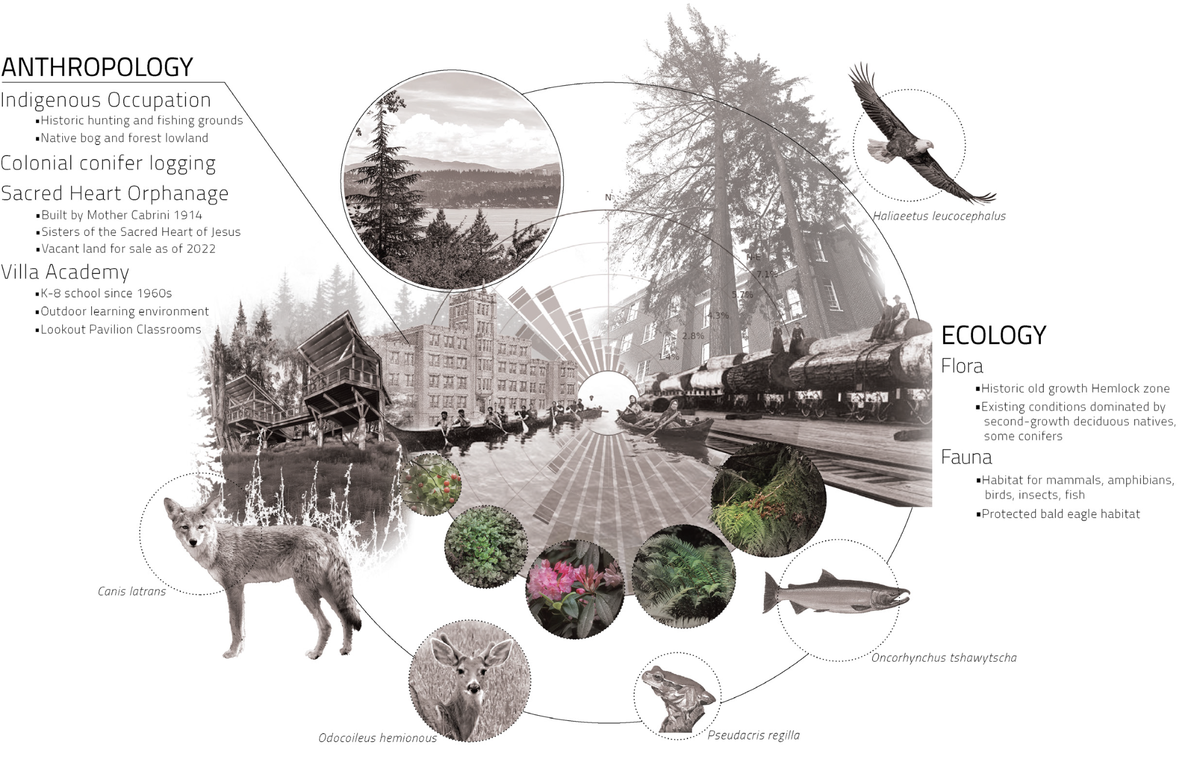
COMMUNITY
ECOLOGY
© Jack Hyland, 2023
Notes:
This graphic is one that I appreciate. Developed by a recent student of mine, I appreciate both its simplistic pattern and critical combination of features that serves to bridge much of the work I have and continue to pursue in bridging communities and knowledge in ecology.

Slide 11
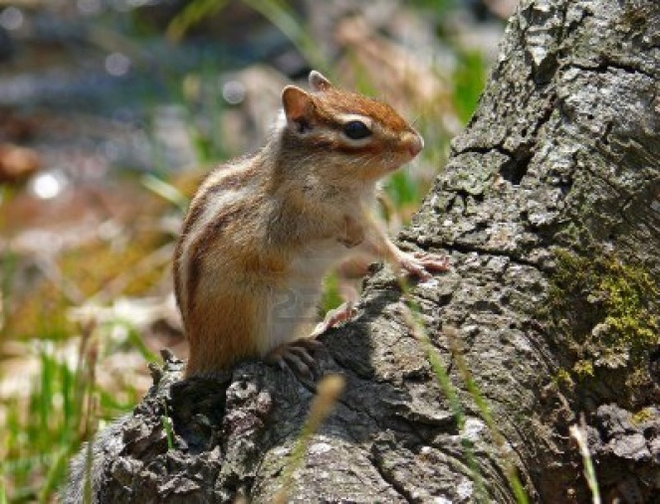
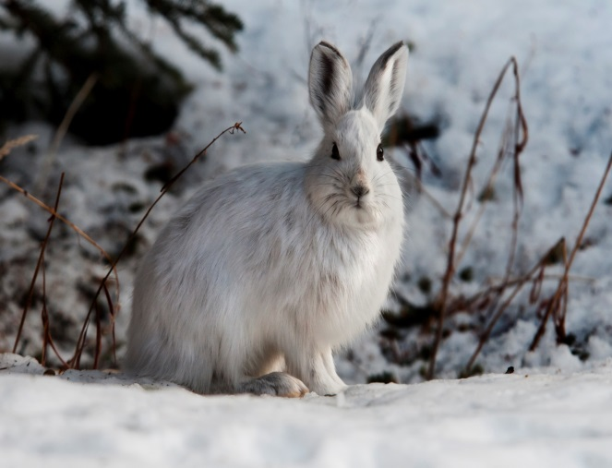
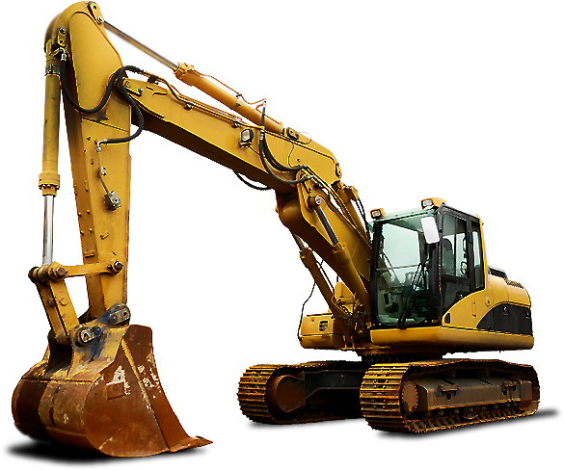
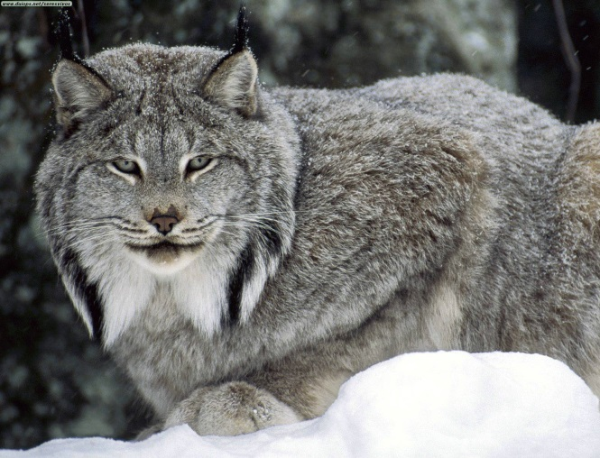
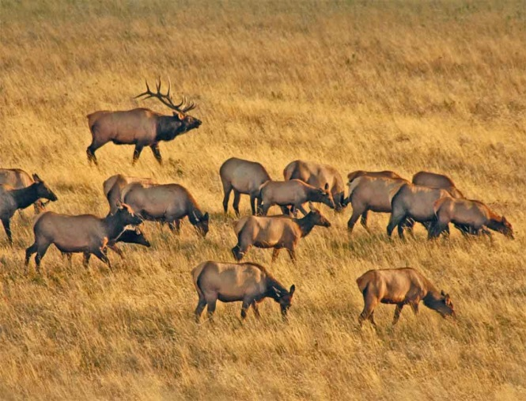
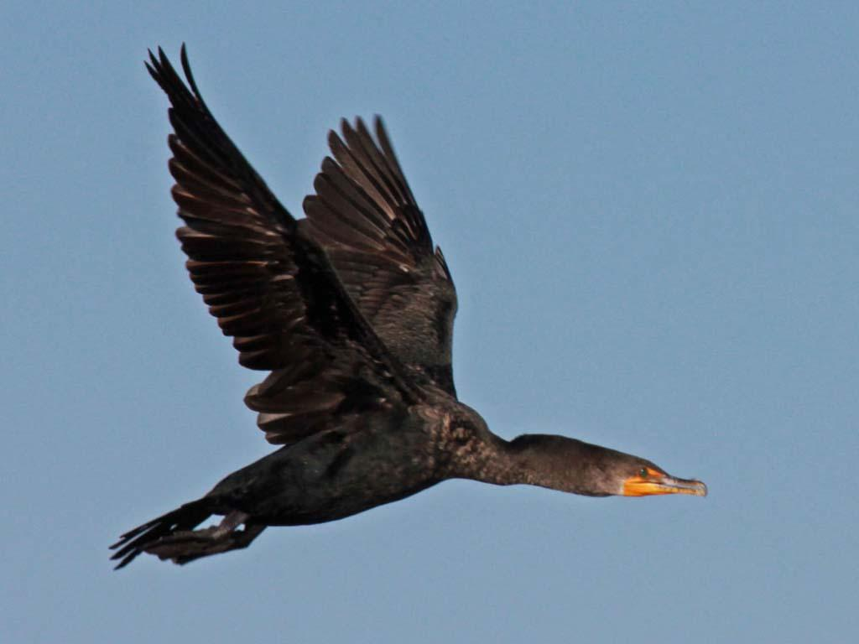
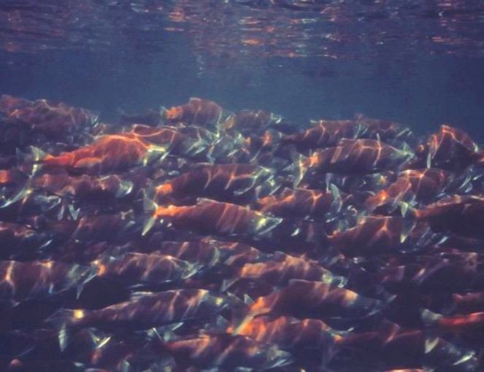
WILDLIFE ECOLOGY
CONSTRUCTION
Notes:
I assume like many of you, my work in this area did not begin in ecological restoration. Before finding this work I had careers as a wildlife ecologist and in construction. While I enjoyed both, separately they did not speak to me as something I wanted to continue long term, but in combination they drew me towards landscape architecture and ecological restoration.

Slide 12
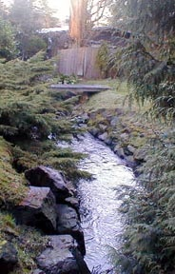
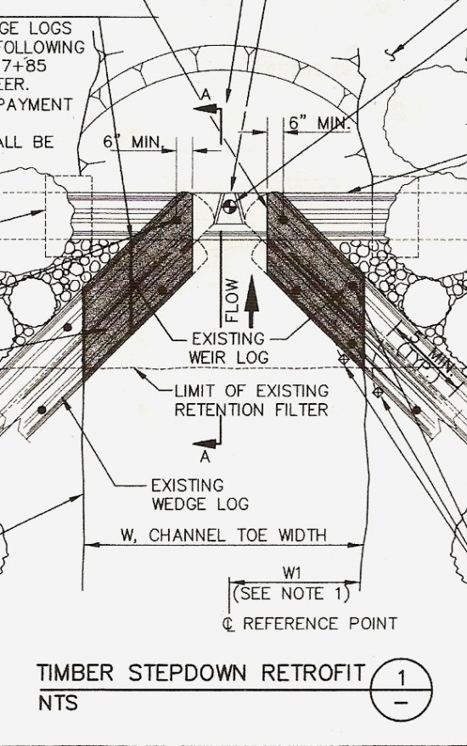
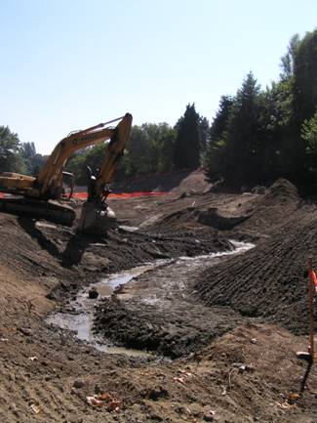
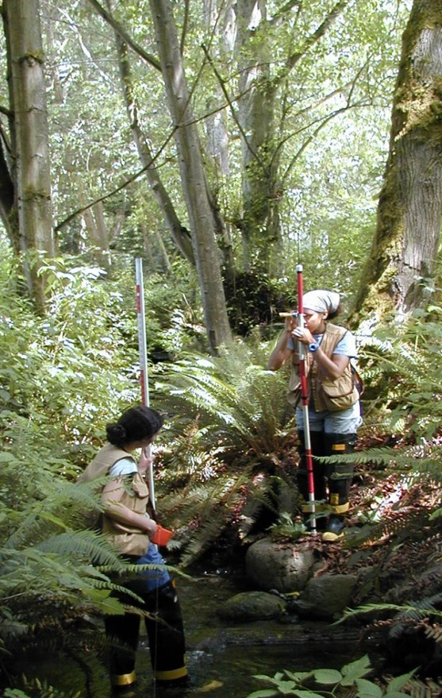
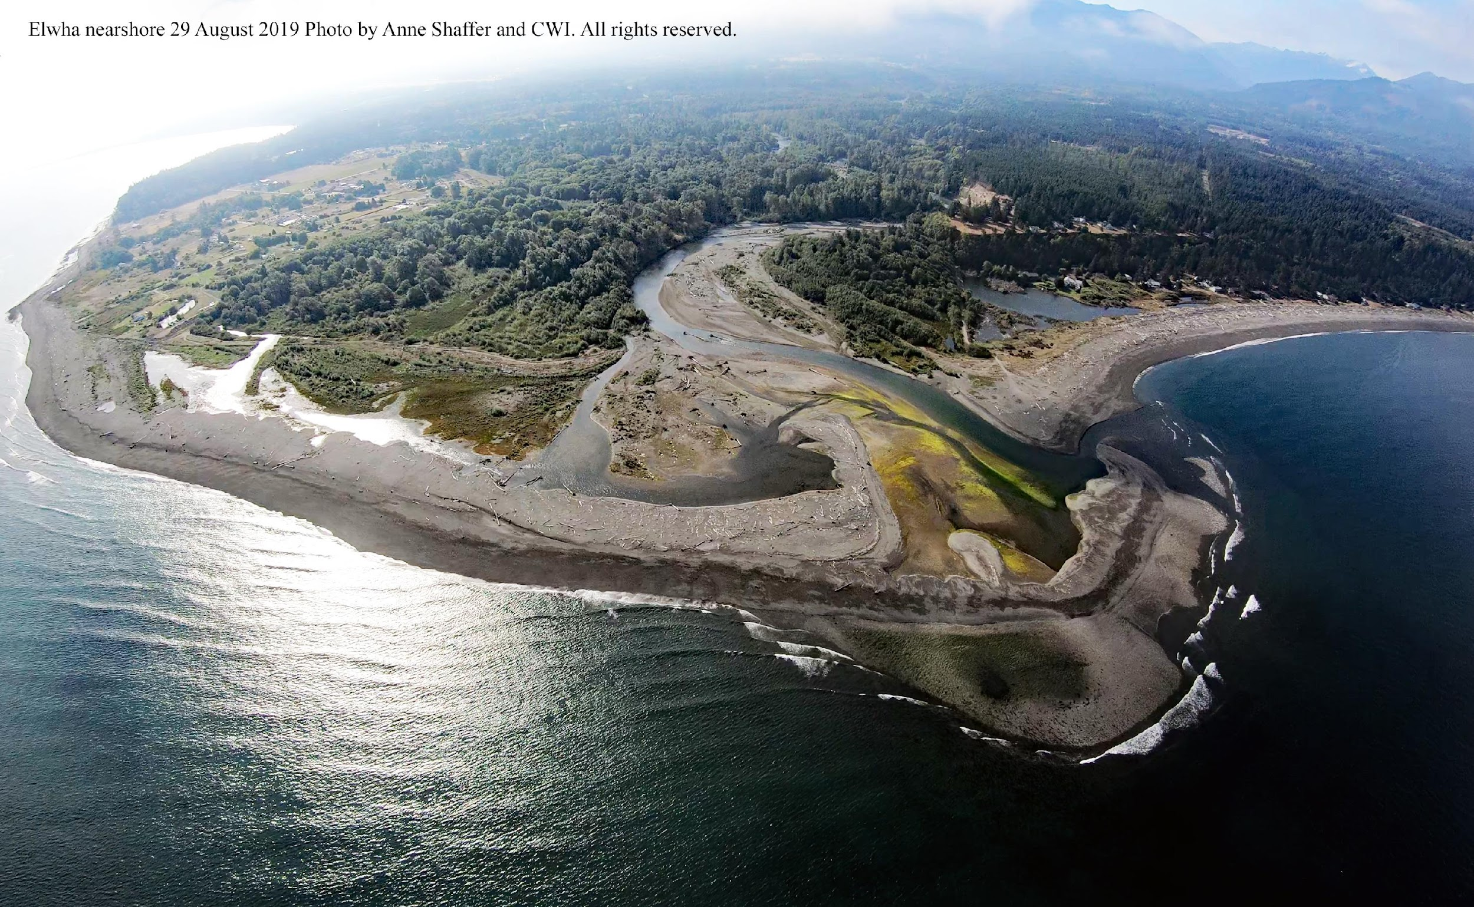
URBAN STREAM REHABILITATION
© Seattle Public Utilities
WATERSHED DYNAMICS
Notes:
When I moved to the Seattle area towards the end of the last century (I don’t know why I like to say that), I pursued both education and professional work in these areas of landscape architecture and ecological restoration – and was fortunate to be offered the opportunities to not only engage with site-based work, but to step back and take a broader perspective to understand basin scale dynamics and how they have, are, and will continue to be influenced by social perspectives, development, policy and economy.

Slide 13
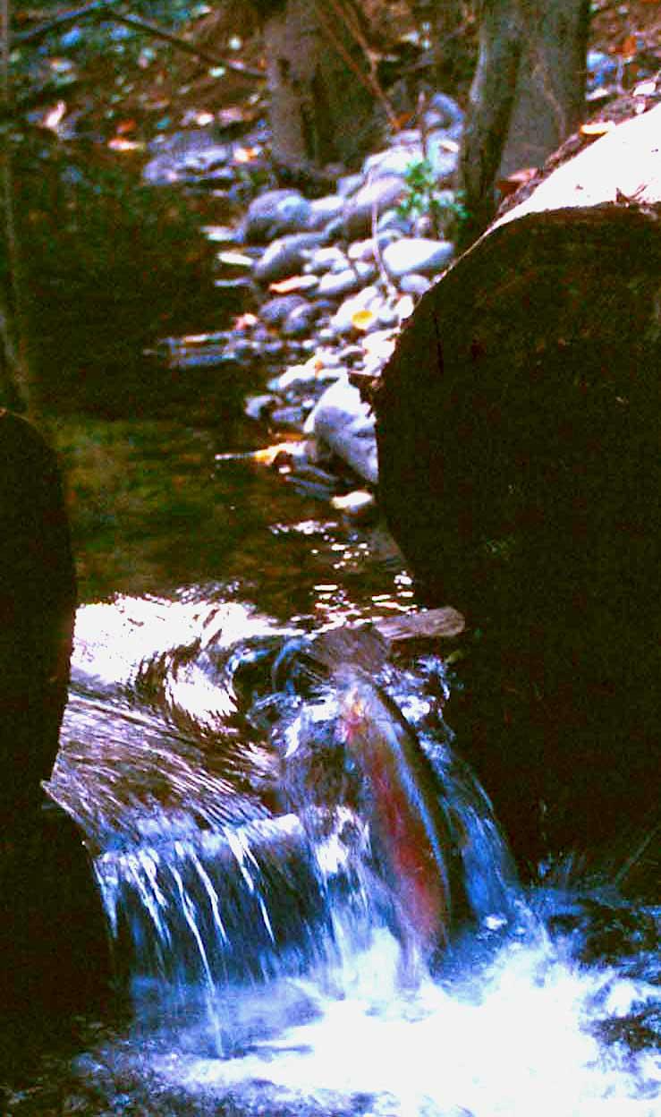
© Seattle Public Utilities
Notes:
Early in my time in Seattle, I was offered an internship with Seattle Public Utilities on their urban stream restoration team. I can honestly say, this position was one of the most influential of my career as I worked with a courageous and dedicated team invested in improving the water quality and stream habitats of some highly degraded yet still productive systems. With this team I was able to build a broader perspective to understand that while the site based work we were accomplishing was important, it was more like putting a bandaid on a festering wound – we needed to think bigger – move beyond the mainstem into the tributaries and beyond that, all the territory on which water fell and was collected in the basin. The work was complex and highly satisfying.
As I was pulling this talk together, I came across a letter of recommendation I had written some time after my employment with SPU for a colleague – I will read a bit here because I think it sums up some of the challenges we faced while also speaking to the community I had the privilege of working with:
I have known [this person] most of a decade; first as colleague, then student, and always as friend. As employees of the City of Seattle and the urban stream restoration team, we trudged through the potent flows of our urban waterways, faced the challenge of rats larger than men, prodded councils for greater support, and hosted communities to embrace their ideas. In all of this, [this person] displayed a resilience and fierce determination that enabled her to conquer any task presented. Her ability to assimilate information, process that data into a cohesive order, develop an elegant and efficient strategy, and implement that directive with intense focus and will were qualities that enabled her to produce success. She is able to acknowledge triumphs and she also can recognize failure. Upon a setback, she would change her trajectory and adapt a new strategic approach for accomplishment and move forward with full determination. She is not one to wallow in defeat.
In all honesty, I believe that each of you in this room hold those same qualities. If you did not, you would not be here today.

Slide 14
Directions
+ Influences
+ Personal Engagement
+ Framing
+ Modeling Knowledge
+ Innovative Practices
+ Next Generations
Notes:
Now I will step into some of the framing for this talk.

Slide 15
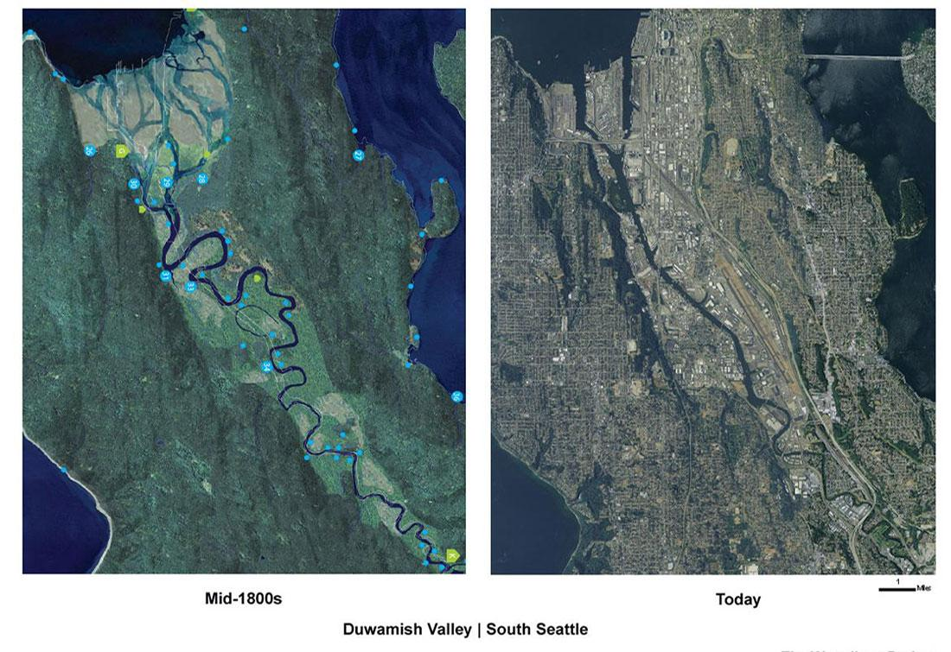
Get Dirty.
© Amir Sheikh / Burke Museum
© Medium
Notes:
Well-trodden intellectual grounds for many in this room are the ethical constructs that evaluate the concepts of environmental restoration – while I won’t delve into those engagements from a 20,000 foot perspective, I will bring forward that the general contemporary understanding that environmental restoration IS a human endeavor whether borne of an innate responsibility towards care or to advance economic norms it is generally understood that it is not a process of historically bound re-creation, but a forward thinking process which philosopher Henry Dicks describes as ”imitationism”.

Slide 16
There is no turning back the clock to former conditions and relationships […] Reinventing the past simply isn’t practical, possible, or desirable. In engaging with prospects for river futures we need to move beyond the rose-tinted impressions of the past that are framed in terms of idyllic [perceptions].
Get Dirty.
- Brierley + Friyirs, River Futures, 2008
© Amir Sheikh / Burke Museum
© Medium
Notes:
Restoration ecologists Gary Brierley and Kristi Friyirs succinctly describe this work in their book River Futures. There is no turning back the clock – we must deeply consider the past, understand the present and look toward the future.

Slide 17
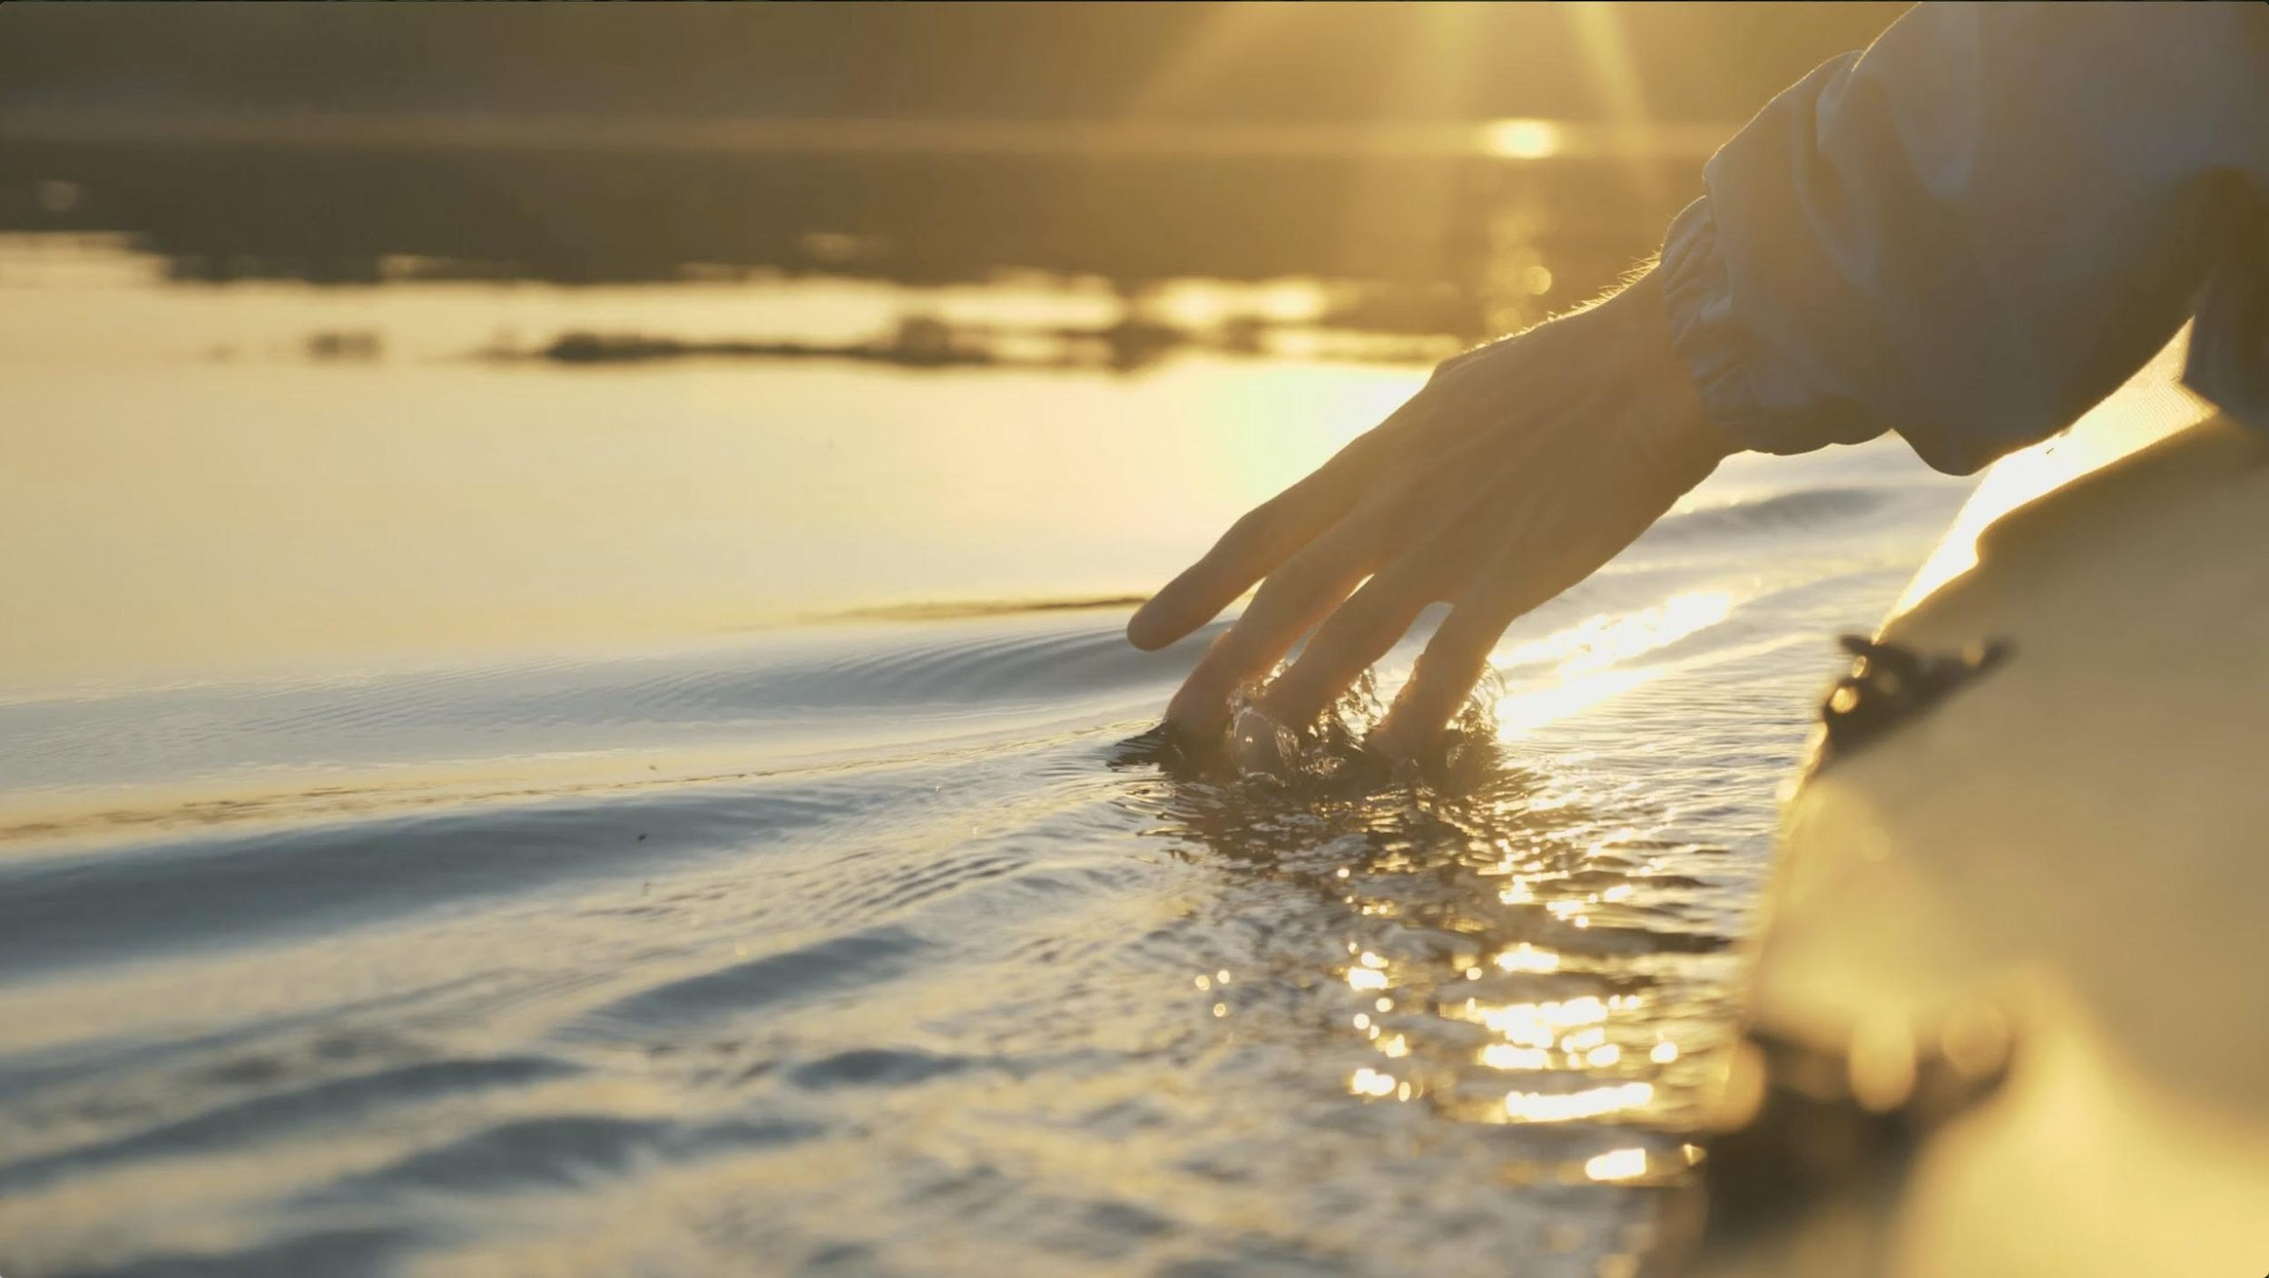
The quest for healthy and sustainable river futures reflects our capacity to develop harmonious relationships between human values and environmental needs.
- Brierley + Friyirs, River Futures, 2008
© Future Rivers, UW
Notes:
Instead, they go on to offer a new projection or quest as described here that is relational – a partnership if you will uniting societal values with environmental and community needs.

Slide 18
The quest for healthy and sustainable river futures reflects our capacity to develop harmonious relationships between human values and environmental needs.
- Brierley + Friyirs, River Futures, 2008
© Future Rivers, UW
Notes:
Yet even within this laudable statement are engrained assumptions about a brighter, more enlightened future. In this, I am at odds with the concept of future harmony based on the reality of my own experiences and perspectives in the field. This work, our work, doesn’t hold to conclusions, but requires long lasting commitments that anticipate, embrace, and build from conflict.

Slide 19
We need to embrace our capacity for conflict, as a point of inflection for reaching toward resolution.
© TechTellum
Notes:
As many of us inherently know, it is not periods of peace and harmony in which advancements in knowledge, practice and effective action are made, but it is through the process of resolution in which new, dare we say innovative, thinking and opportunities emerge.

Slide 20
INNOVATION
CONFLICT
RESOLUTION
© BigBangPartnership
Notes:
For it is only through resolution that we can see new avenues for innovation. I appreciate this graphic from BigBang Partnership, yet I am again challenged by the linear thinking and the harmonious, straight-line results that follow the lightbulb period of innovation.

Slide 21
INNOVATION
CONFLICT
RESOLUTION
© BigBangPartnership
Notes:
In my experience, innovations do not lead to pre-ordained solutions or harmonious futures, but often lead toward other issues and concerns to be addressed. While we learn through these experiences, we also recognize that the functional and operational challenges of management are not finite – much like the ecosystems we all are trying to work within – they grow, change and evolve.

Slide 22
Directions
+ Influences
+ Personal Engagement
+ Framing
+ Modeling Knowledge
+ Innovative Practices
+ Next Generations
Notes:
MODELING KNOWLEDGE

Slide 23
COMMUNITY
We have the knowledge and the ability, but are we building the capacity to sustain the effort?
ECOLOGY
© Jack Hyland, 2023
Notes:
From our collective experiences and knowledge, I have a strong feeling that we have the knowledge and the ability to have tremendous impact to improve our waterways, rivers, and tributaries, but I have concerns over whether we are building the capacity to sustain our efforts over the long term.

Slide 24
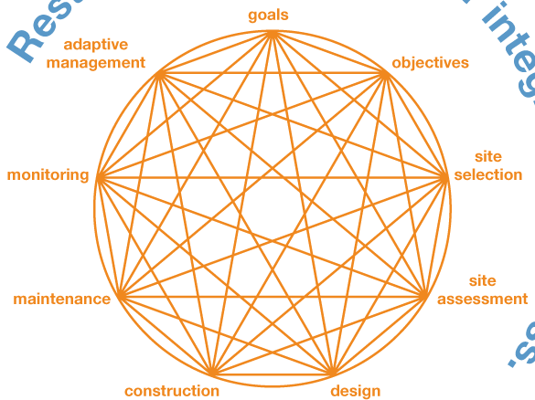
From a Western science perspective, we are ever-increasing our knowledge and frameworks
SPACE
TIME
© Linda Krippner + Susan Buis
Conceptual model credited to Susan Buis and Linda Krippner
Notes:
From a Western science perspective, we are ever-increasing our knowledge and frameworks for developing strategies and approaches to improve environmental conditions. I have used this simple graphic, created by past colleagues Linda Krippner and Susan Buis, in client meetings, in courses, as well as with policy makers. I appreciate its simplicity in articulating that the globe of actions within any given project relate to others, and at times we need to step back to readdress and adapt to changing needs and conditions. It has proved to be highly successful in these efforts.

Slide 25
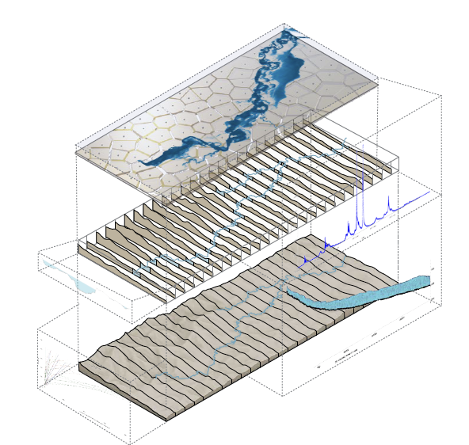
We are evolving our approaches to model the complex dynamics of basin characteristics and river flows.
© Zachary McBride, 2023
Spatial
Notes:
Yet, the simplicity of that graphic pales in comparison to the complexity of models and analysis we are now able to run to build understanding that serves to both simplify and ratify our decision-making.

Slide 26
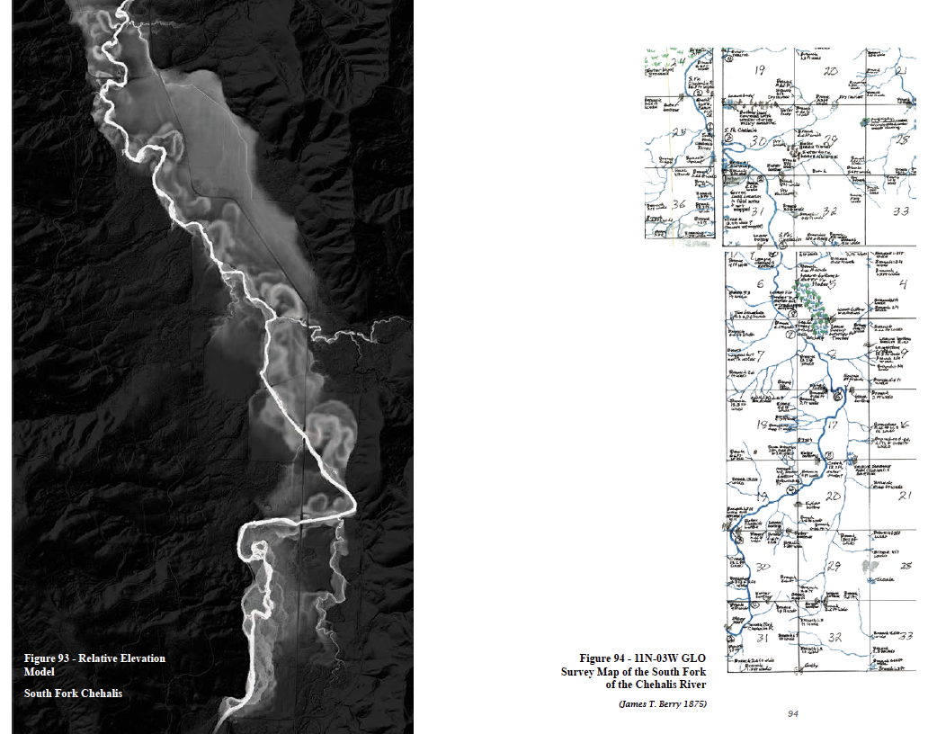
Temporal
© Zachary McBride, 2023
Notes:
With these new models we are increasingly gaining efficiency in understanding an projecting across time – to build from past conditions and the current situation to better articulate potential impacts of a given project.

Slide 27
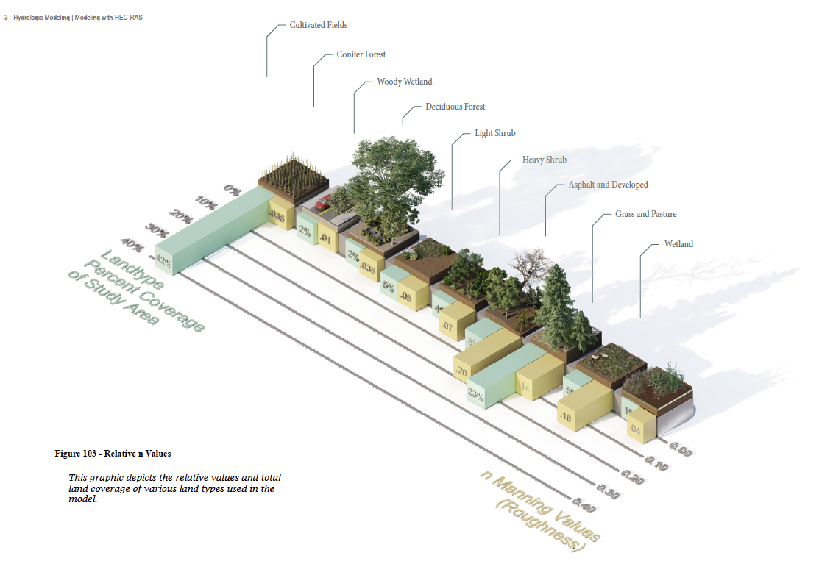
Spatial + Temporal
© Zachary McBride, 2023
Notes:
We can even determine the specifics of landcover types to better understand how water does and will flow as it moves through a basing from headwaters and tributaries to the mainstem and its confluence with other waterbodies.

Slide 28
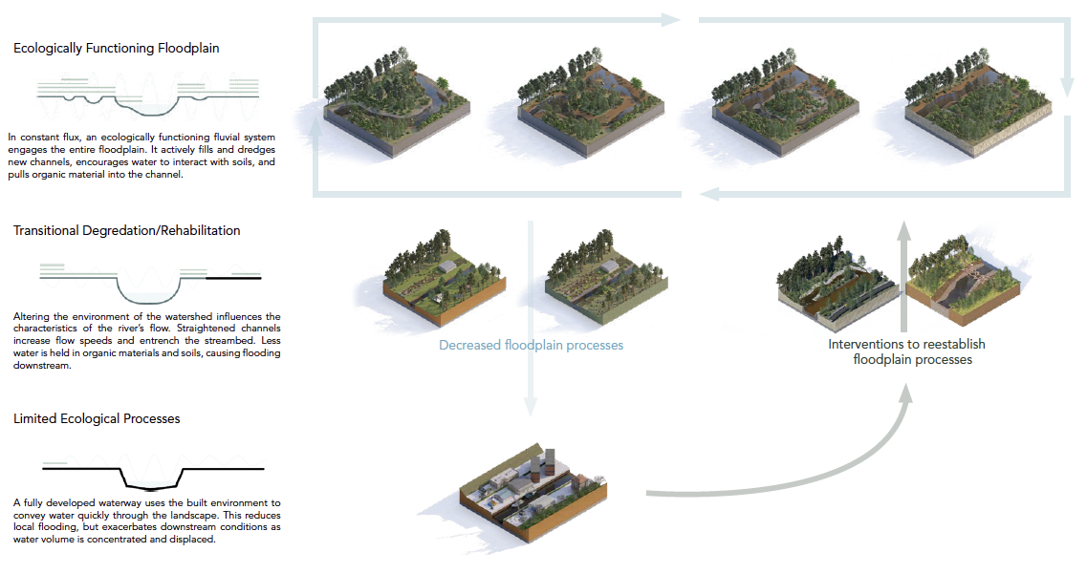
© Zachary McBride, 2023
Notes:
And through this all, we can develop informed decisions on reach and site based strategies and approaches for addressing current problems

Slide 29
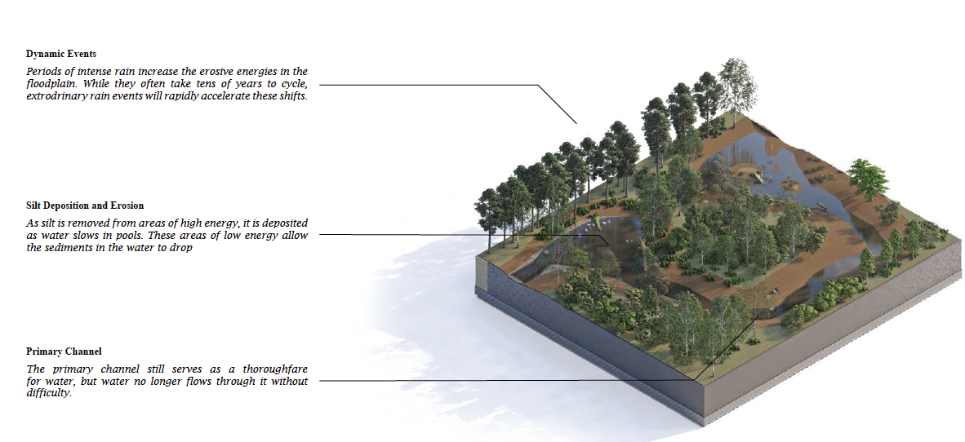
© Zachary McBride, 2023
Notes:
And then go on to justify our results based on our scientific approach and thinking.
For the past several slides, I would like to acknowledge another recent student of mine, Zachary McBride, for the graphics. He challenged himself with his thesis to develop a clear understanding of contemporary strategies in this area of research and work while working on a tributary in the Chehalis Basin.

Slide 30
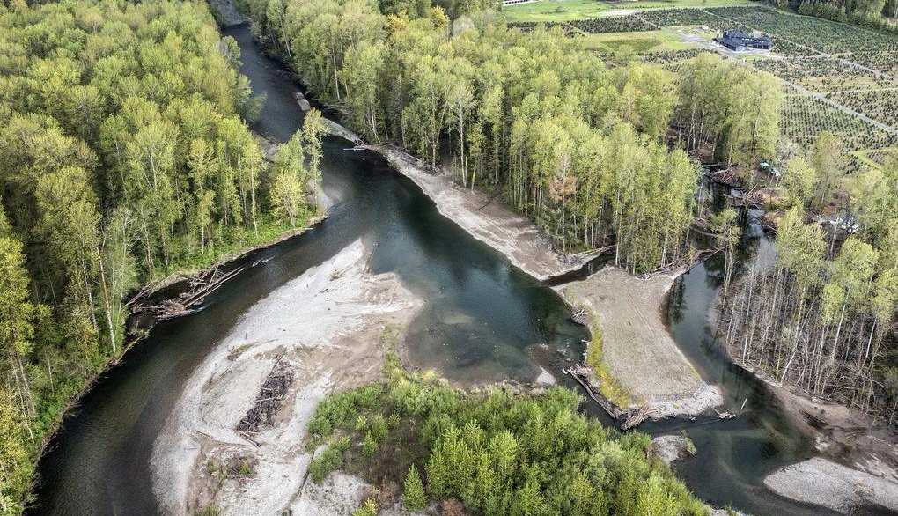
Levee Removal Project
Green River
© Seattle Times, 2022
Notes:
And these often result in highly successful collaborations and projects such as the recent Levee Removal project East of Auburn with the priorities of conserving land, protecting people, mitigating floods, and diversifying habitat.

Slide 31
Directions
+ Influences
+ Personal Engagement
+ Framing
+ Modeling Knowledge
+ Innovative Practices
+ Next Generations
Notes:
INNOVATIVE PRACTICES
All of these activities and approaches should be lauded, for without this work we would – in some instances – be flying blind. But they are not all that is important in this work. In terms of building capacity to sustain this work, they may be the least important.

Slide 32
“The surface flows of environmental science put forth the idea that once we get enough information, we’ll make a change in management. Yet despite overwhelming evidence, old policies and patterns of land use persist, and so degradation and species loss accelerate.”
- Cleo Wolfle Hazard
Underflows
Notes:
As my colleague Cleo Wolfle Hazard writes in his book, Underflows – despite all these great advancements and projects we are still losing ground – we are still placing the metaphorical band aids things that fester.

Slide 33
“Solving humanity’s ecological, economic and political problems and solving humanity’s knowledge creation and epistemological problems are connected projects […] We are faced with a clear mandate – to be more inclusive , more justice focused, and more clearheaded about the implication of what we do and to build to support these goals.”
- Stephanie Malin + Meghan Kallman
Building Towards Something Better
Notes:
Instead, sociologists Stephanie Malin and Meghan Kallmen argue that we need to do more. To be effective at sustaining our impacts we must work to me more inclusive, justice focused, and clear-headed about our near and long-term goals.

Slide 34
Our challenges lie, not in what we know or don’t know, but how we face our problems. Directional solutions take small steps along a path, but relational practices allow us to stand tall, build greater vision, make connections, and adapt to change.
-
Notes:
I extend their work by arguing that our challenges lie, not in what we know or don’t know, but how we face our problems. Directional solutions take small steps along a path, but relational practices allow us to stand tall, build greater vision, make connections, and adapt to change

Slide 35
Relational practices are not new or unique.
-
Notes:
This stated, I fully recognize that relational practices are not unique – With deep respect, within our region they date to the cultural origins of our indigenous families and extended by the commitment of many individuals and organizations, many in this room, that have furthered this wisdom – yet the volume of this wisdom has often been muted by the colonial chants of progress and efficiencies.

Slide 36
Relational practices are not new or unique.
-
+ civic environmentalism
+ community science
+ feminist technosciences
+ landscape citizenship
+ kinship relations
Notes:
Relational practices have been transcribed by contemporary theorists and practitioners to include but not be limited to categorizations such as: civic environmentalism (of which I am complicit), community science, Landscape citizenships, and kinship relations to name a few. I’ll take a brief look at two.

Slide 37
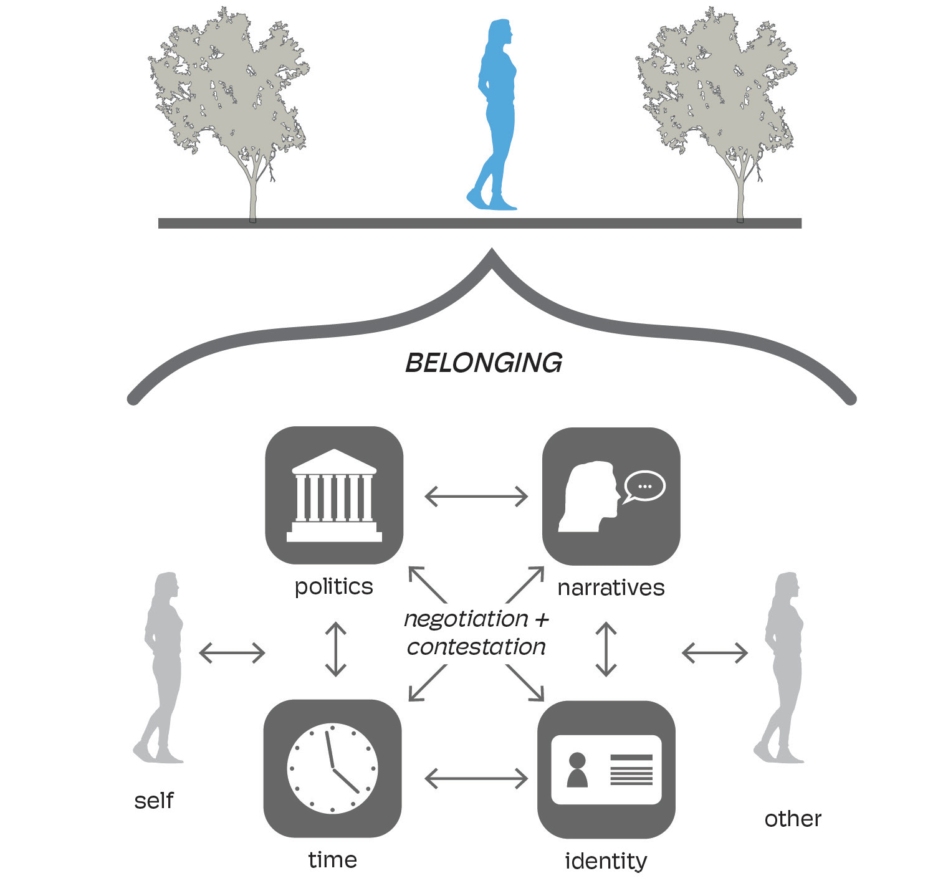
Landscape Citizenship describes the processes of identity-formation and belonging in relation to place
© Tim Spenser, 2023
Notes:
Landscape citizenship as a concept relates to the processes of identity formation in relation to place. Such approaches embrace the multiple layers of identity for self and community emphasizing the dynamic, negotiated nature of belonging to a place through multidirectional influences of family, community, politics, culture, and economy.

Slide 38
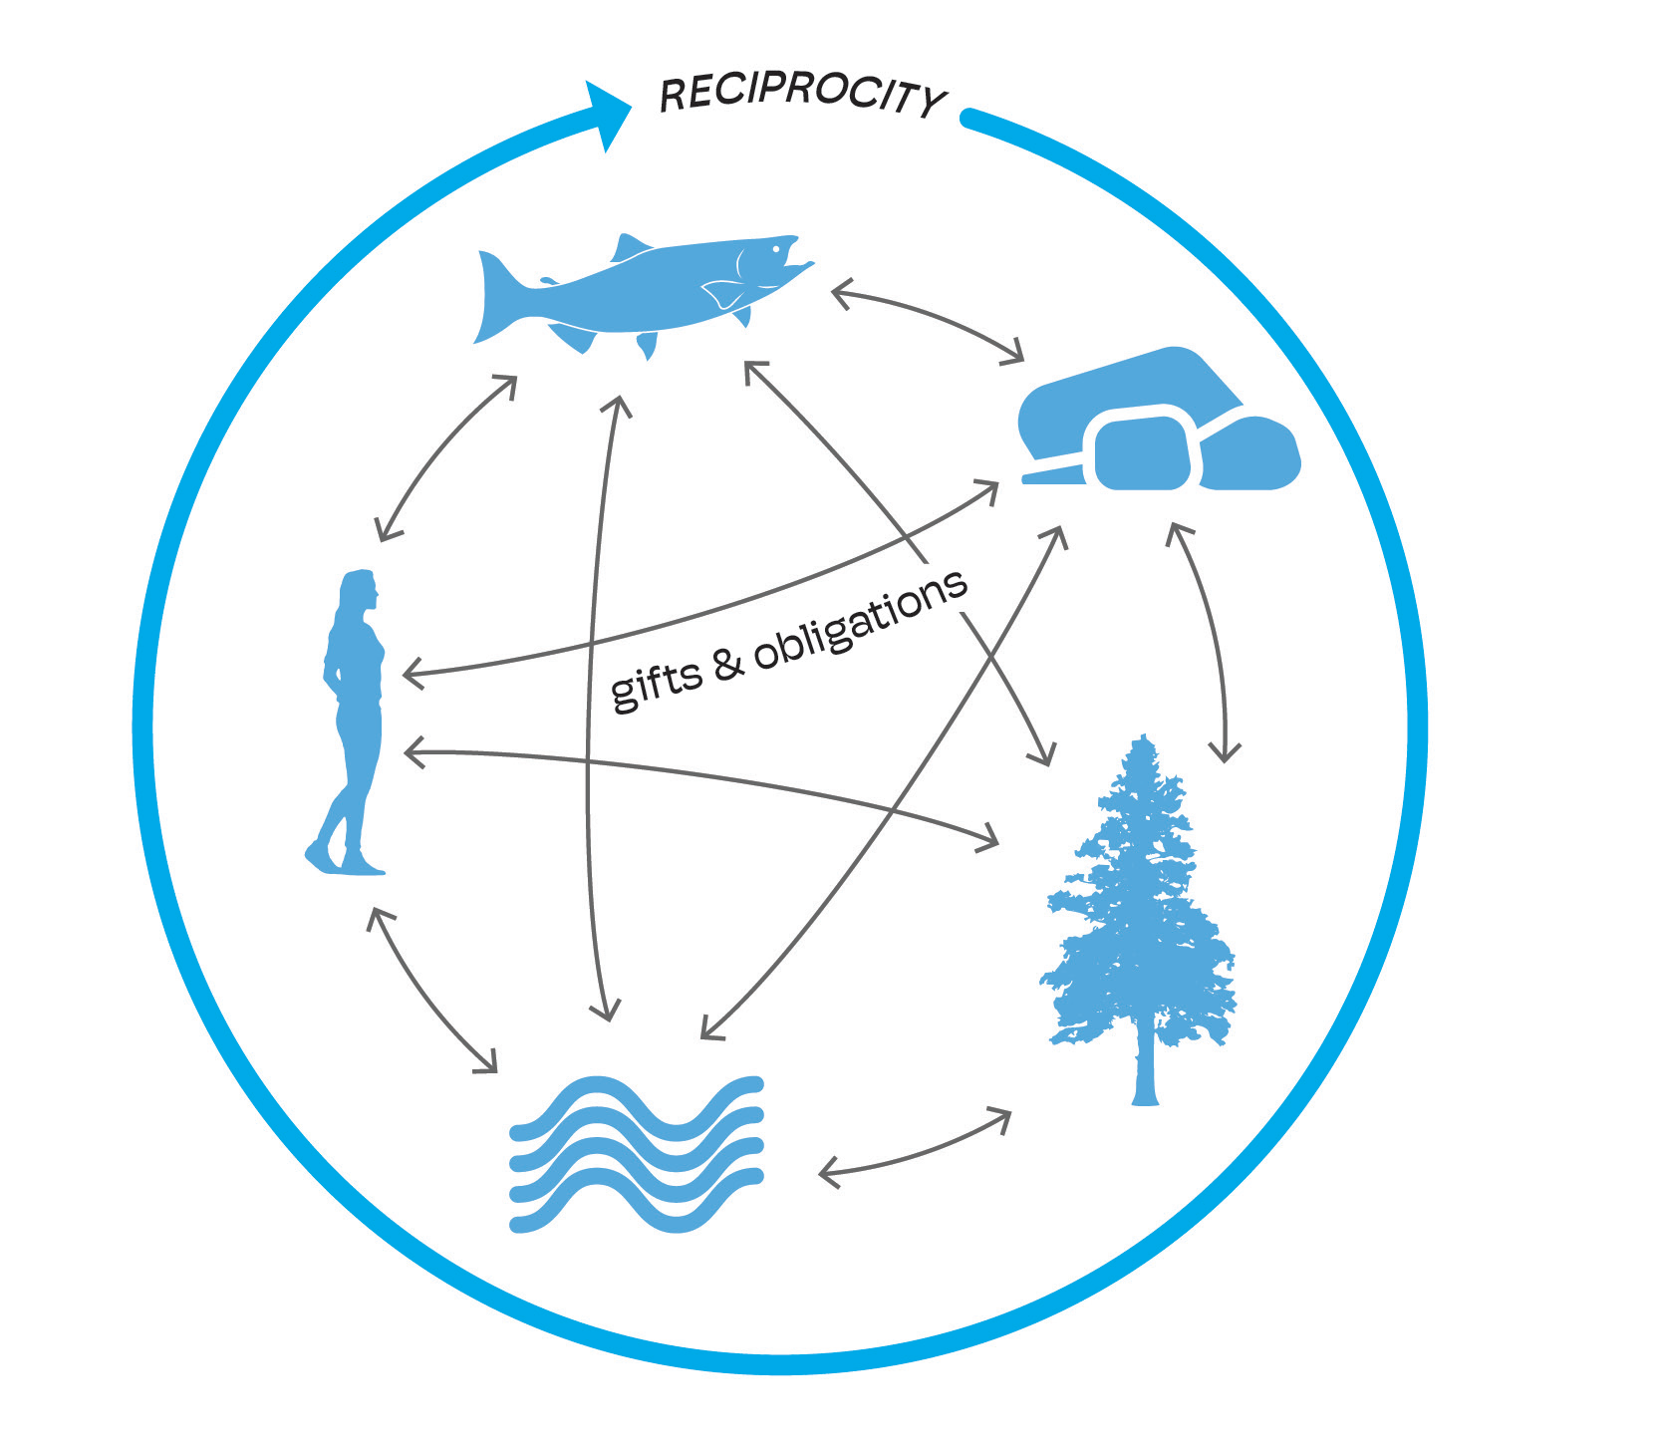
Kinship Relations seek to unveil the reciprocal obligations and gifts between people and their non-human neighbors
“Land is a verb, […] Land never settles. It is about relations between the material aspects some people might think of as landscapes — water, soil, air, plants, stars — and histories, spirits, events, kinships, accountabilities, and other people that aren’t human.”
Max Liboiron
Pollution is Colonialism
© Tim Spenser, 2023
Notes:
In turn, Kinship Relations recognizes that dynamic land relations are always highly specific because they arise out of particular, unique qualities of place and time. These cyclical
linkages are an acknowledgement and reinforcement of the relatedness
and interdependence of people and land.
Hopefully, the work of Max Liboiron has crossed many of your desks and digital feeds as I believe their holistic approach to bridging western science and kinship relations offers a potential model of many for effectively serving to strengthen our capacity to sustain and extend our efforts.

Slide 39
Trust
Consensuality
Transparency
Reciprocity
Accountability
© Tim Spenser, 2023
Notes:
While each of these approaches emphasize different relational aspects between society and nature they each ascribe to these 5 requirements: The need for trust, consensuality, transparency, reciprocity, and accountability.

Slide 40
Directions
+ Influences
+ Personal Engagement
+ Framing
+ Modeling Knowledge
+ Innovative Practices
+ Next Generations
Notes:
NEXT GENERATIONS
To bring this all together, I’d like to offer a few quick thoughts.

Slide 41
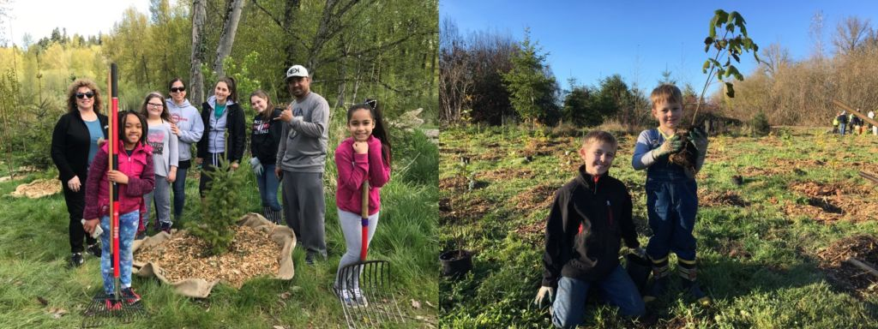
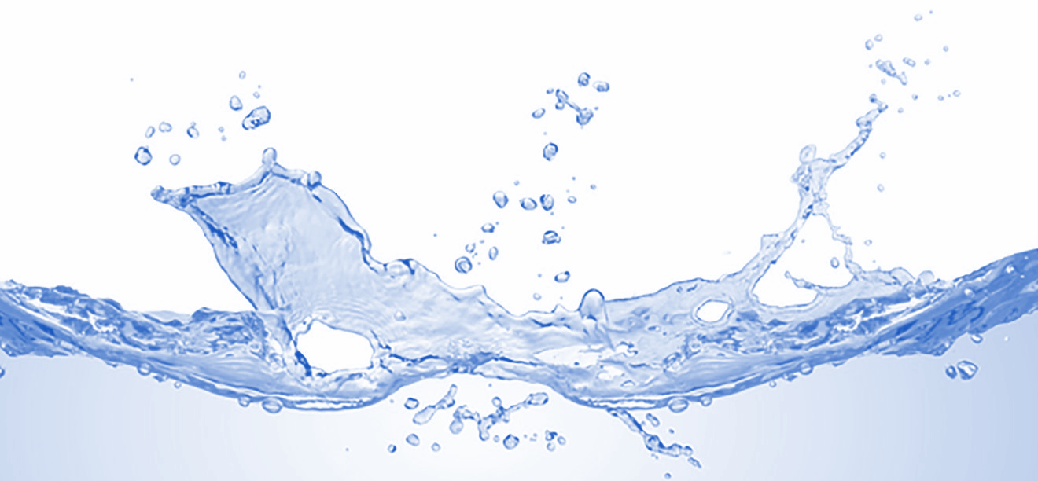
© (left to right) Zizheng Cheng, Nick Krittawat, Jeanette Dorner, Katie Beaver
The challenges we face are inter-generational.
Trust - Consensuality – Transparency – Reciprocity – Accountability
Notes:
The reason for needing to build capacity to sustain is that the problems we face are not ours alone – they are intergenerational – and if we can build these requirements into each of our responsibilities, we establishing that capacity to sustain our good and intended efforts.
I, by no means mean to insinuate that this work is not happening within the Green Duwamish watershed – in fact these images are drawn from individuals, organizations, and agencies already collectively engaged, but to remind us all that leading with these requirements in our own ways will serve to establish our collective legacy for future generations and continue to set the stage for what comes next.

Slide 42
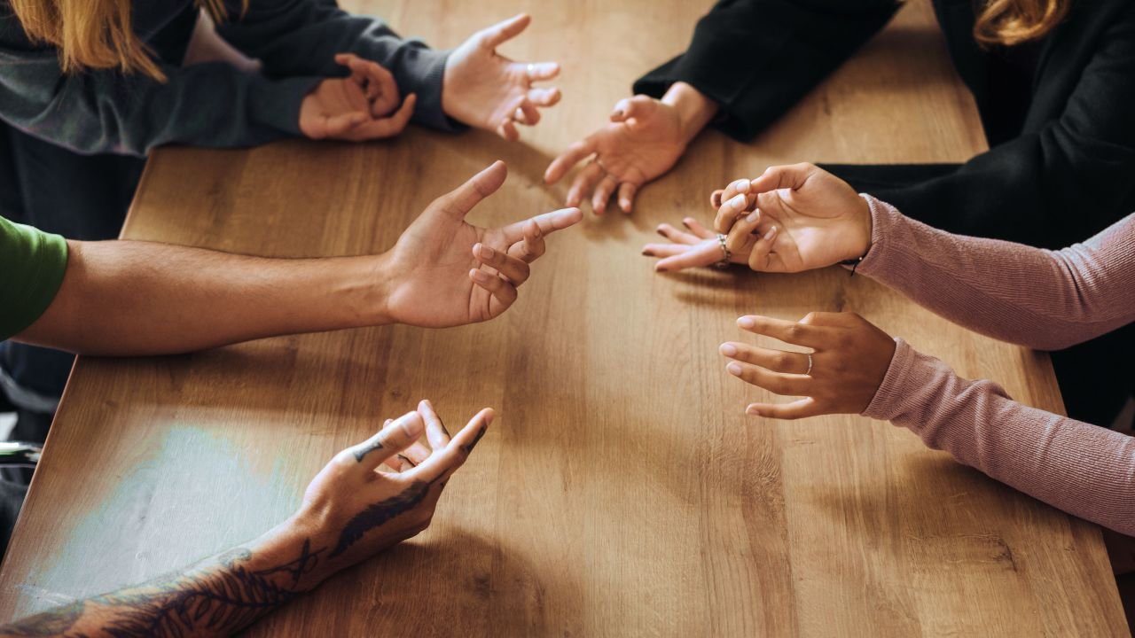
Be
Collaborative..
© Medium
Notes:
So, be collaborative – it builds trust, conensuality, and transparency

Slide 43
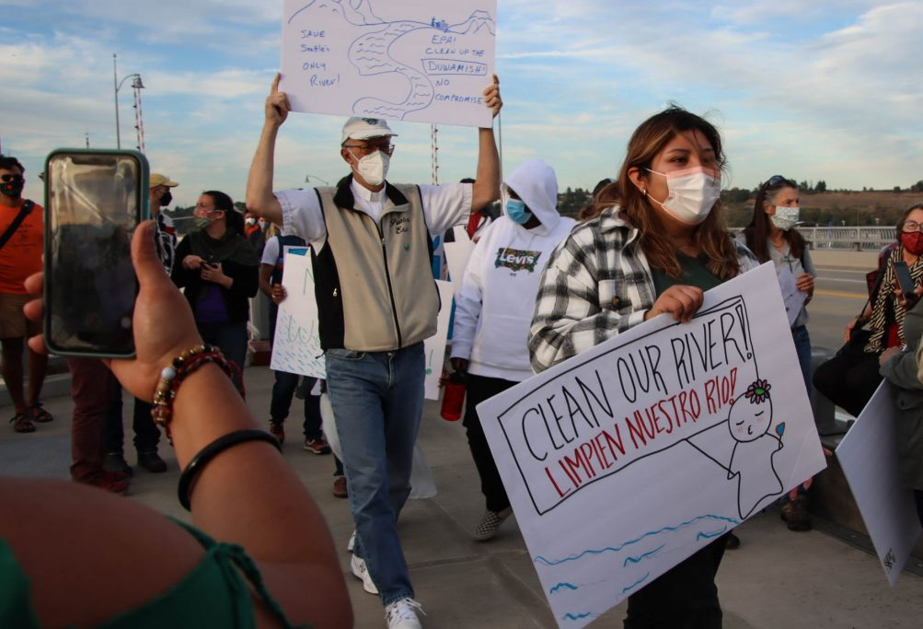
Be
Gracious.
© West Seattle Blog
Notes:
Be gracious to perspectives and approaches that may not align directly with your own as it extends consensuality and reciprocity

Slide 44
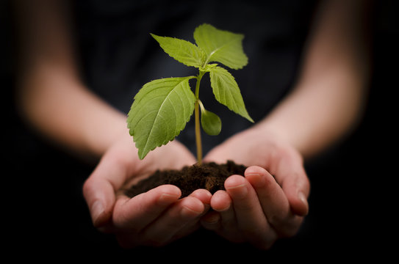
Be
Collaborative..
Be
Kind.
© Medium
© Adobe
Notes:
Be kind. No more needs be said about this – other than it is a foundational human concept that serves as the first step along the bridge toward mentorship and sharing.

Slide 45
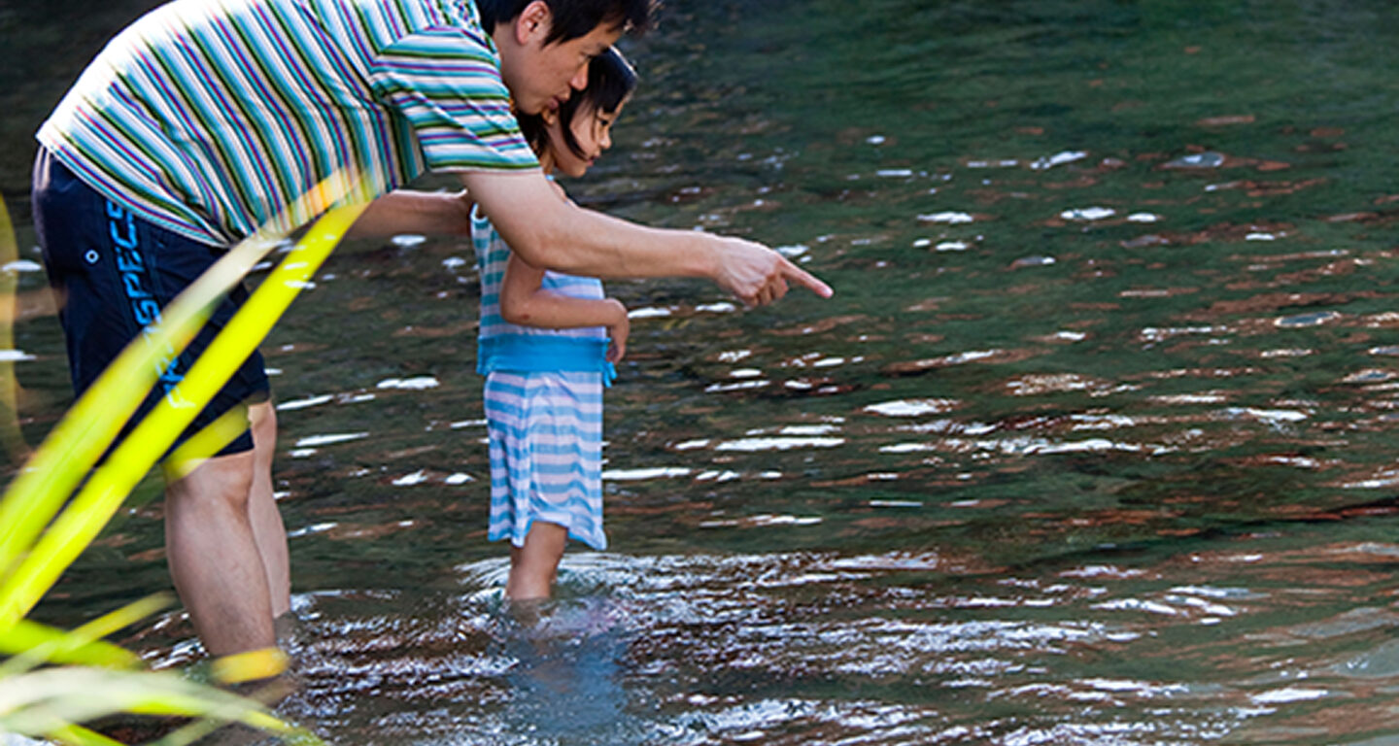
Get Dirty.
Share
Knowledge.
© Mikyoung Kim
© Medium
Notes:
Share Knowledge as it enables transparency, trust, and accountability.

Slide 46
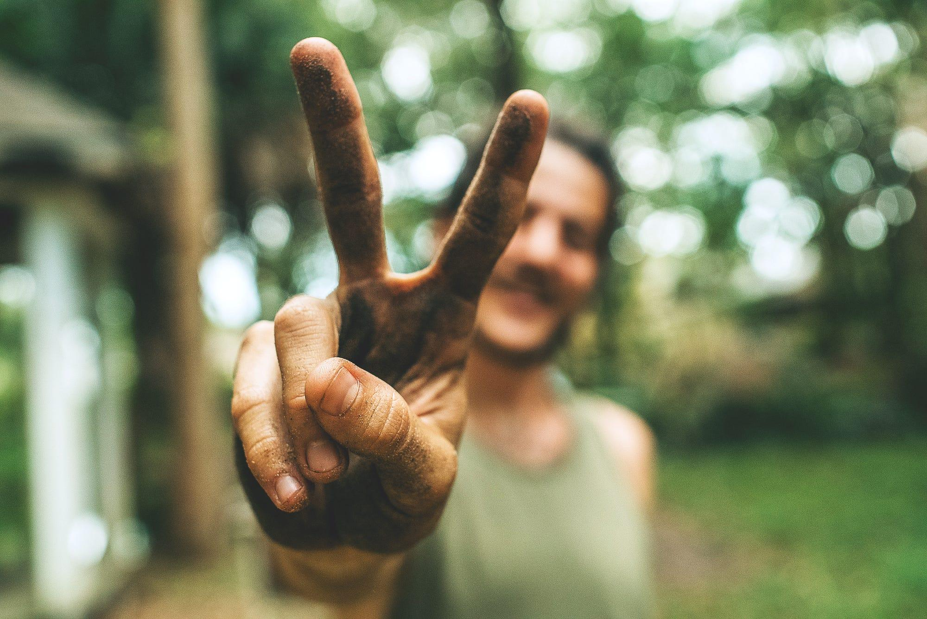
Get Dirty.
© Medium
Notes:
But most importantly, get DIRTY – In this, I mean place your hands in the dirt, feel the earth – and do it with others.

Slide 47
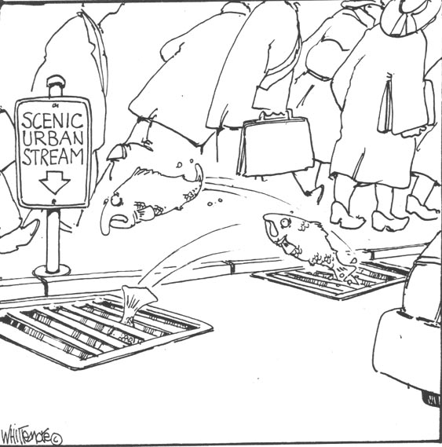
Hold Humor.
© Thomas Whittemore
Notes:
Finally, maintain your humor – As we look back upon what has been accomplished, all of you in this room should be proud of your contributions, and while the complexity of issues that are laid out in front of us are challenging, convoluted, and daunting remembering to consider deeply on impacts and potential, be deliberate in your actions, and reflect on the results, but do so with a bit of humor and remember that your work makes a difference in many ways, but most importantly the difference is made not in what you leave behind, but who you encourage and support in moving forward.

Slide 48
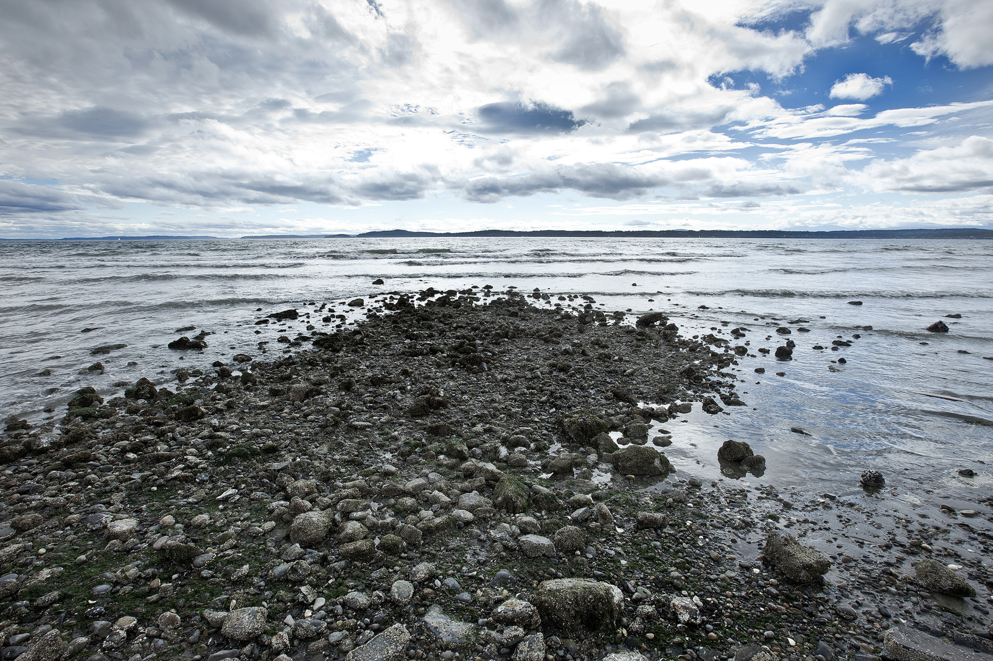
Thank You.
Notes:
Thank you for your time today. I deeply appreciate each of you.

